Slide 1

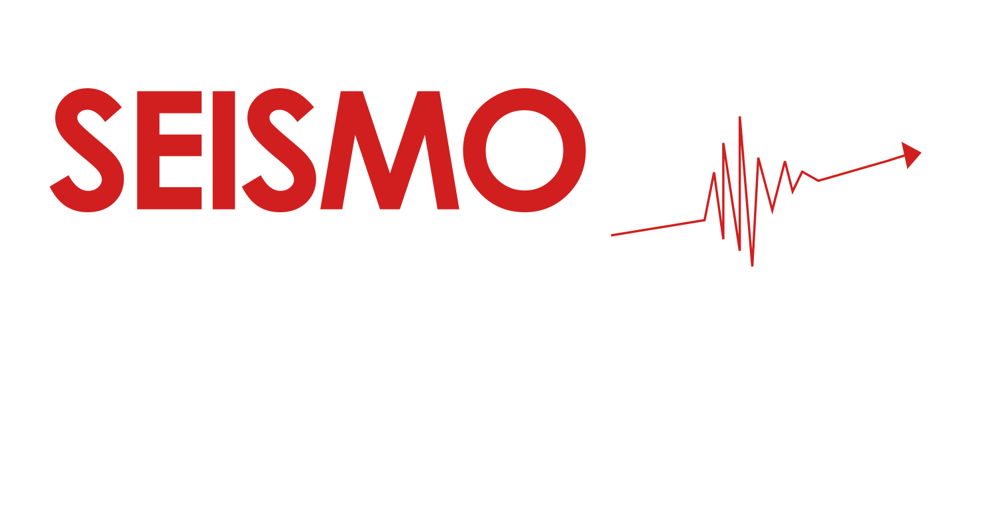
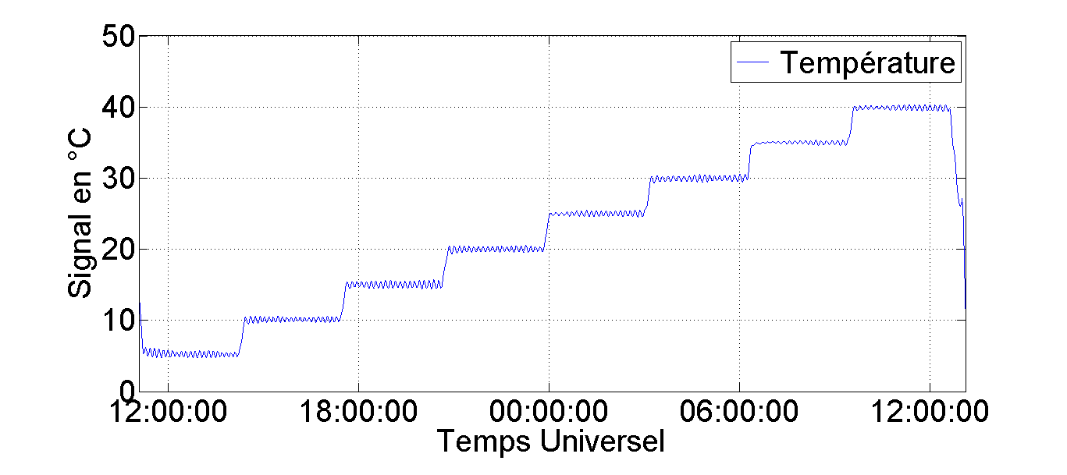
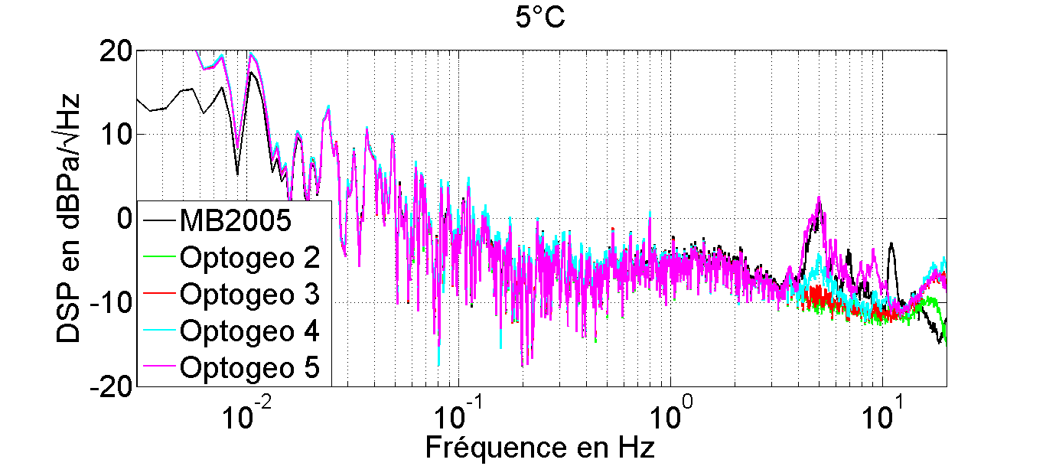
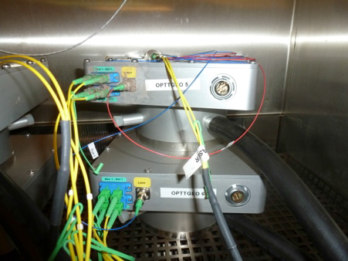
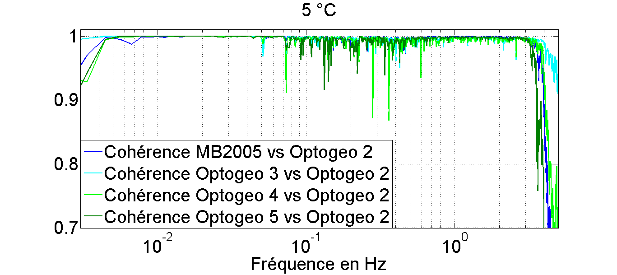
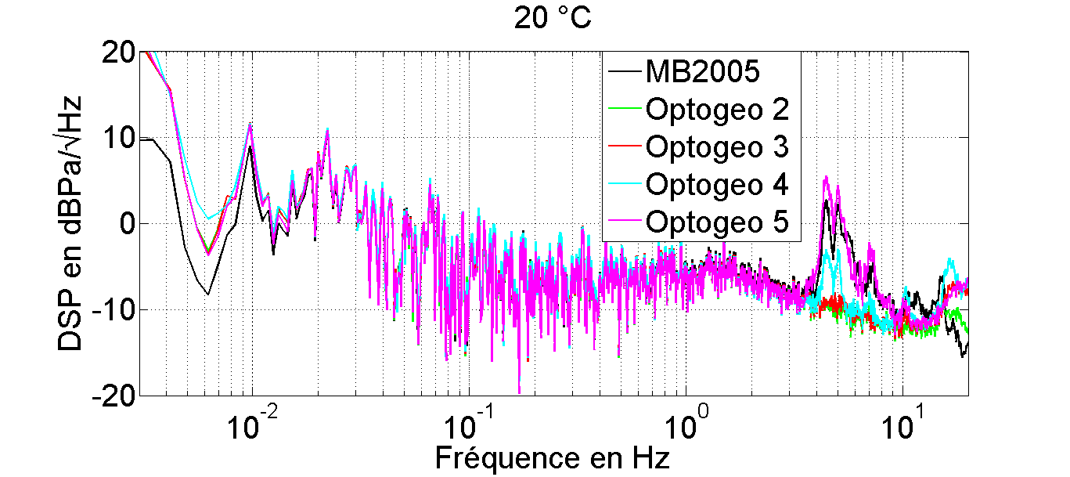
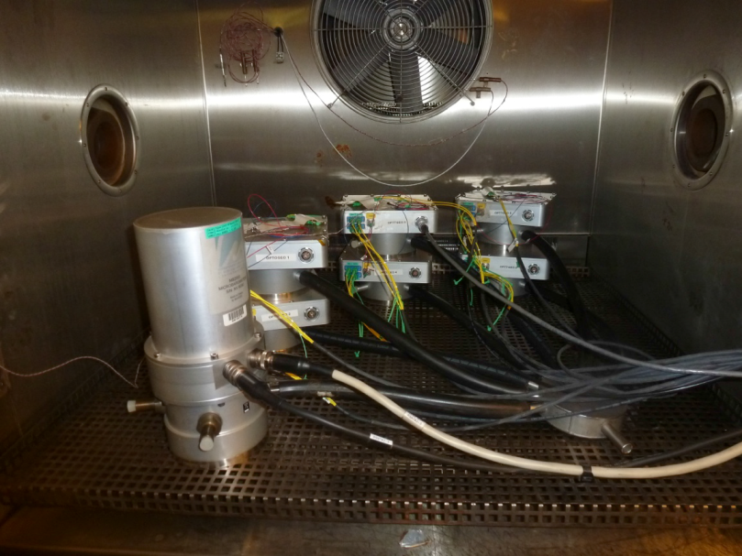
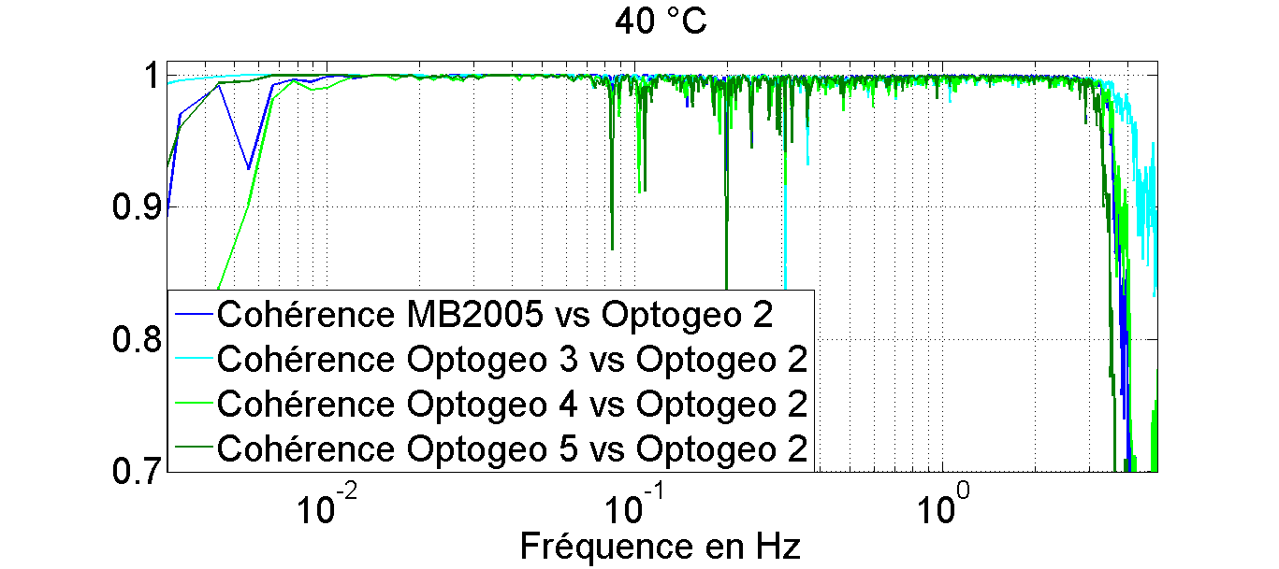
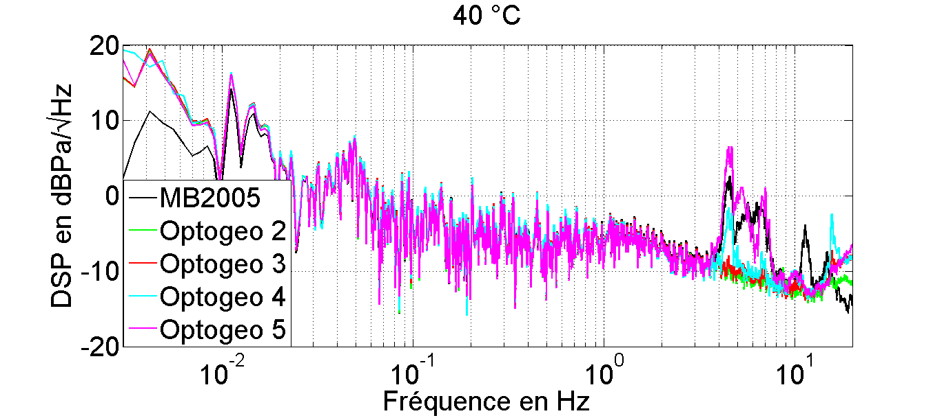
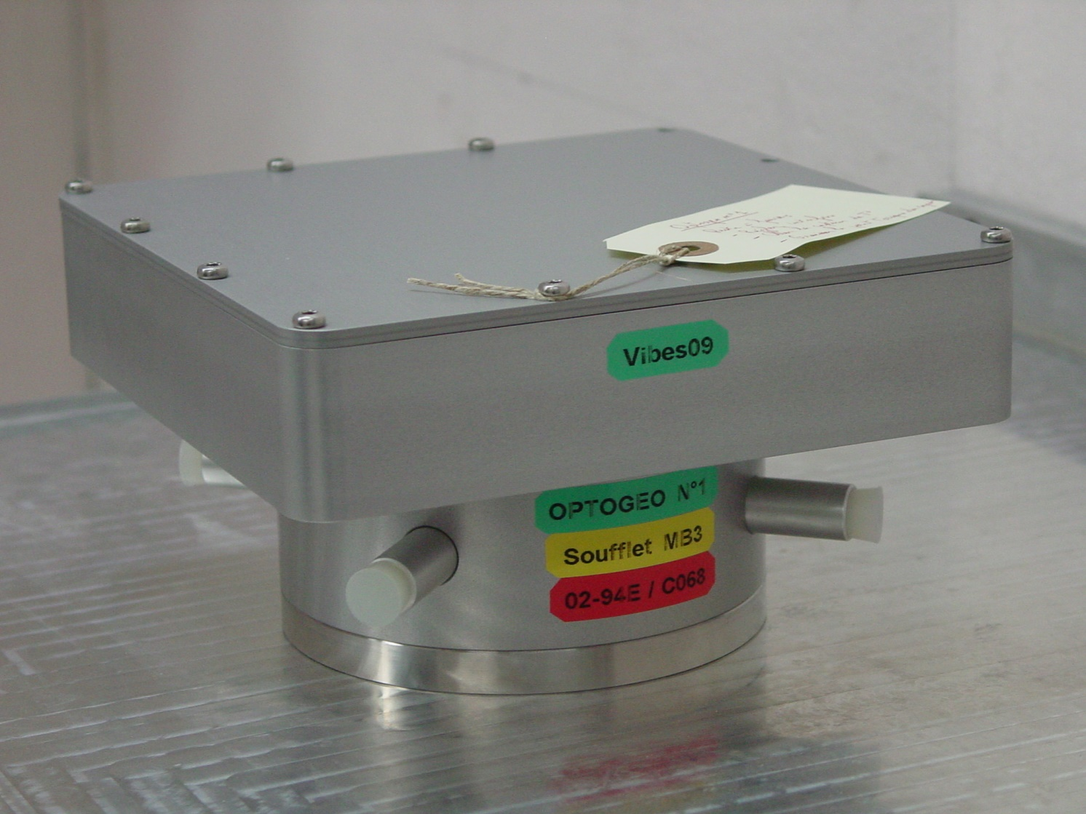
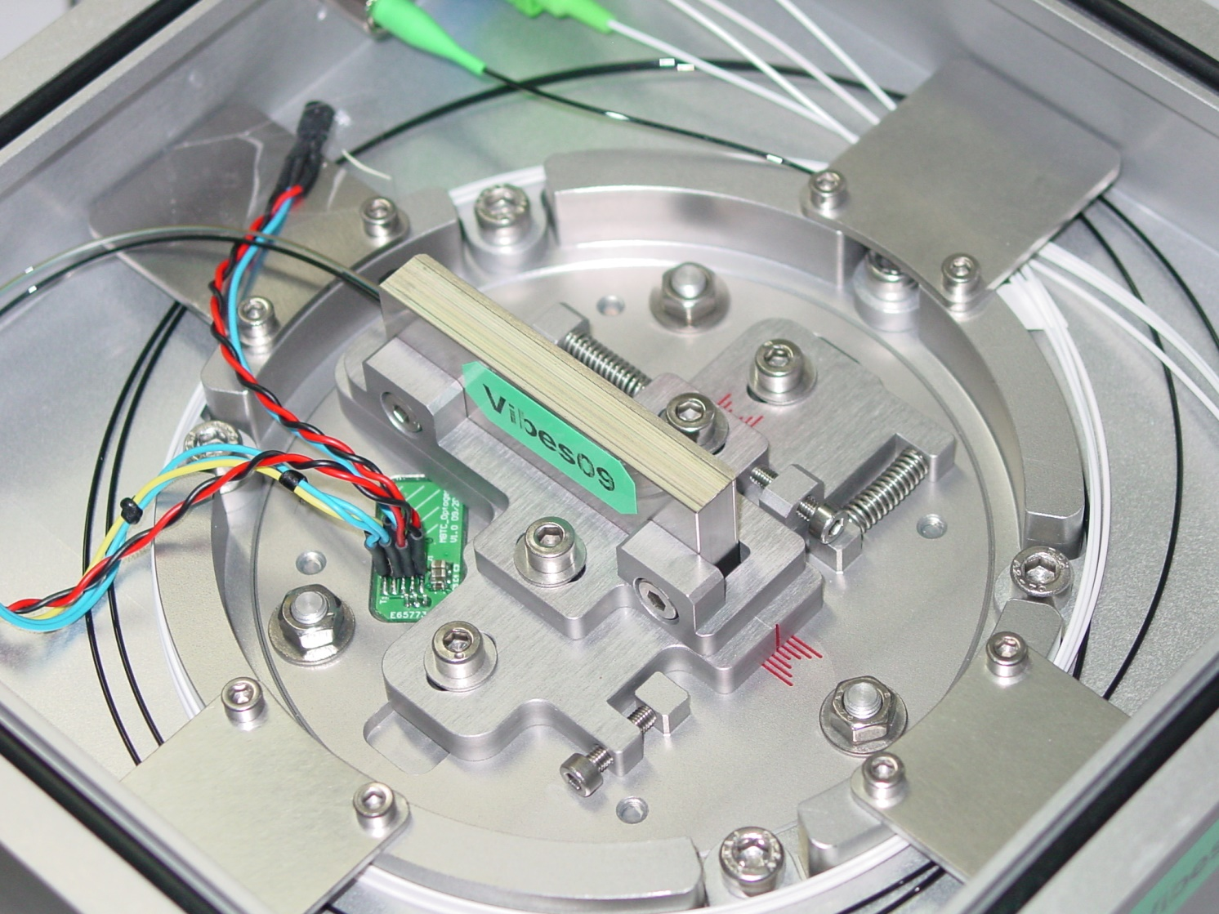
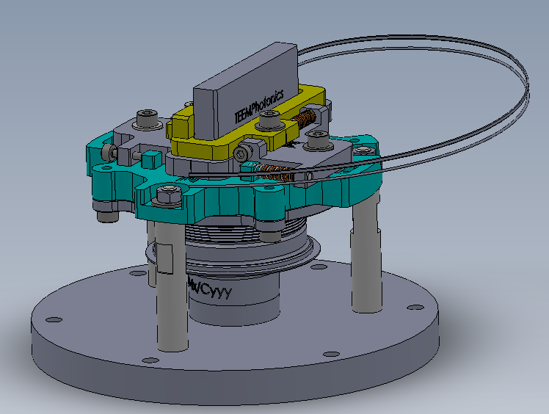
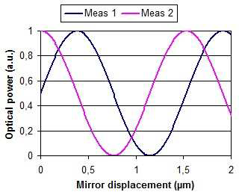
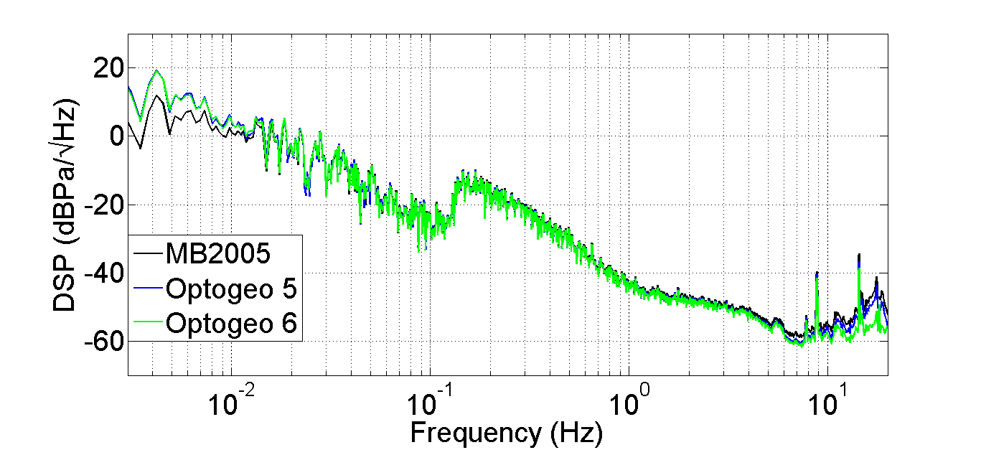
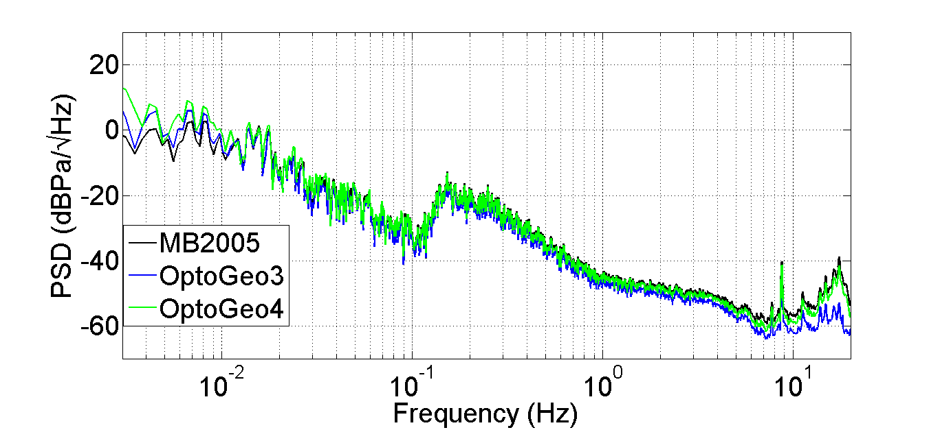
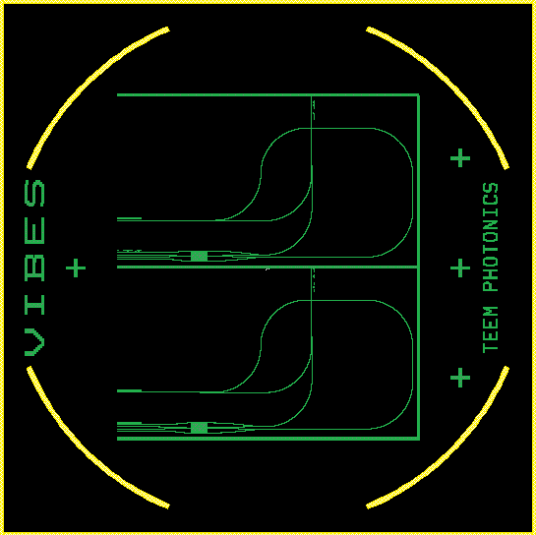
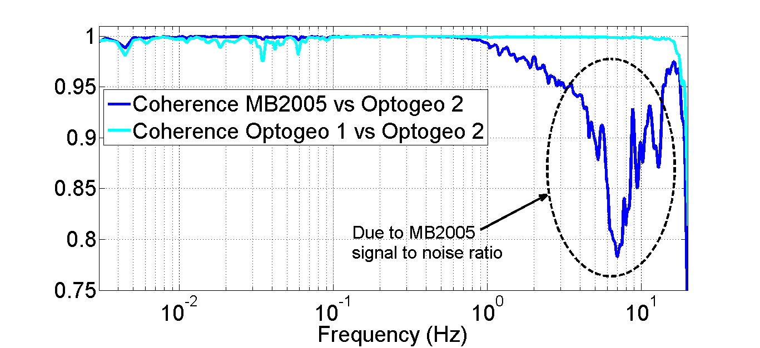
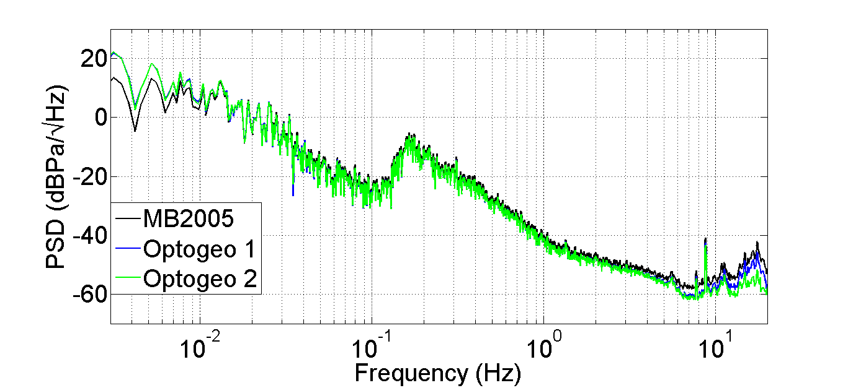
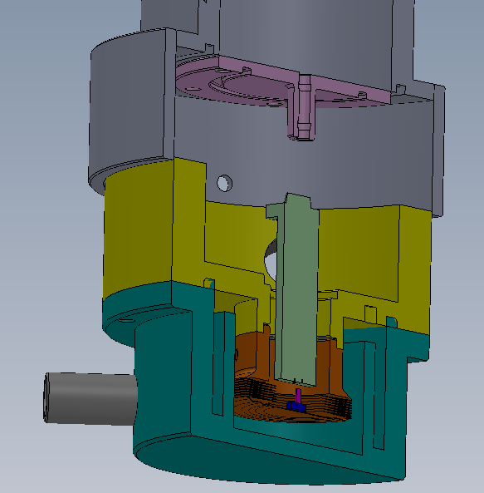
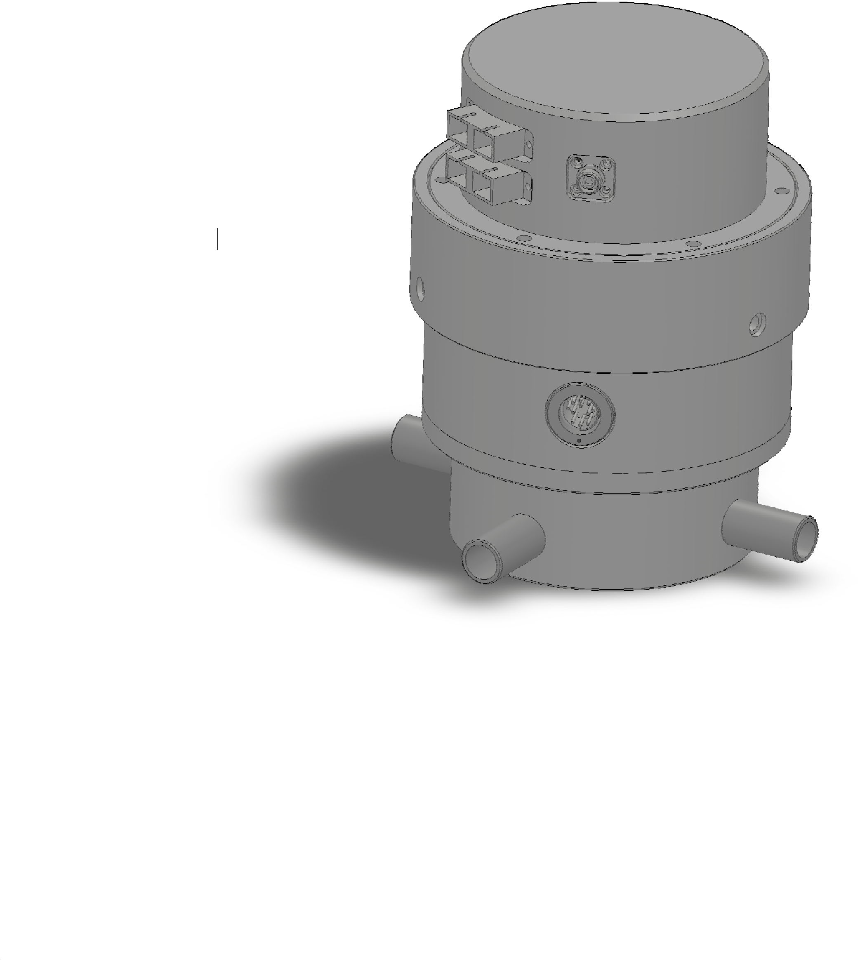
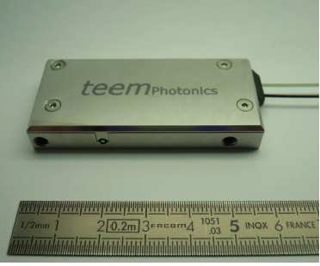
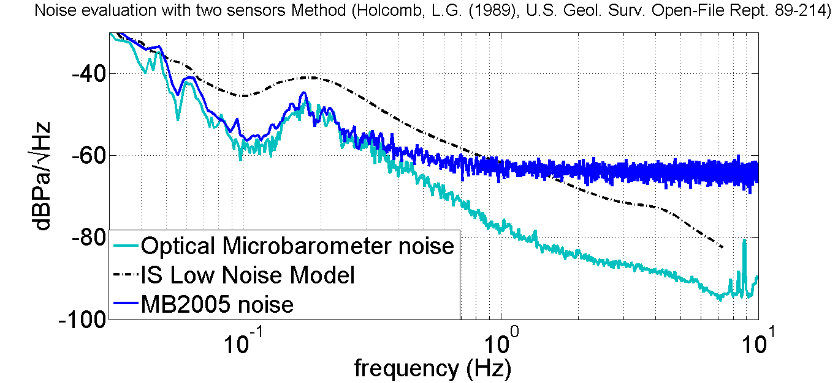

New optical microbarometer
T3.1-P19
5
Effects of temperature
SnT 2015, Vienna Austria
Thermal test:
From 5 °C to 40 °C
Step : 5 °C
Abstract
CEA DAM (designer of MB series) and PROLANN / SEISMO WAVE (manufacturer and seller of MB3) have associated their expertise to design a new optical microbarometer:
We aim at thinking that changing the electromagnetic transducer by an interferometer is an interesting solution in order to increase the dynamic and the resolution of the sensor.
We propose a future optical microbarometer which will enlarge the panel of infrasound sensors. Results with a first configuration are presented here.
Microbarometer principle
3
1
First prototype
Digital microbarometer
Optical area
Analog microbarometer
Pressure
variation
Mechanical transducer
Displacement
Movement transducer
Analog voltage
Digital data
Low thermal effects on infrasound sensitivity compared to MB2005*
* MB2005 thermal drift is less than ±0.1 hPa/°C
Digitizer
6
Effects of altitude
Interferometer
Aneroid capsule area
Interferometer
Fiber
optic
Axial deformation: measurement principle
Transversal deformation: due to symmetrical errors during manufacturing
Risk: misalignment due to transversal deformation
Measurement: Observation of Optical beam intensity variation with altitude
LVDT or
Magnet-coil
Optical
beam
Moving
mirror
Advantages:
1/ Better resolution for the
total bandwidth
2/ No adjustment with altitude
3/ Less optical adjustment
compared with other
optical technology
Drawbacks:
1/ At present time: price
2/ Fiber optics need lot of space
3/ More losses compared with
other optical technology
Aneroid
capsule
Aneroid
capsule
Aneroid
capsule
Alt.= 0 m
Optical beam
Current microbarometer
Optical microbarometer
Moving mirror
2
Aneroid
capsule
Aneroid capsule
Alt.= 2000 m
Interferometer principle
4
Very low effects at an altitude of 2000 m for sensor with MB3 aneroid capsule
Low effects at an altitude of 2000 m for sensor with MB2005 aneroid sensor
Comparison with MB2005
Devices under test:
One microbarometer MB2005
Six optical microbarometers:
Optogeo 1, Optogeo 2 and Optogeo 3 used a MB3
aneroid capsule with the corresponding sensitivity
Optogeo 4, Optogeo 5 and Optogeo 6 used a MB2005
aneroid capsule with the corresponding sensitivity
7
Future design
Drawbacks of the first prototype:
Sensitivity of optical measurement to environmental parameters such as humidity
Solution:
To insert interferometer into the aneroid capsule under vacuum
Integrated optics technology
1- Interferometer is designed with
optical waveguide
2 - Optical waveguide are
obtained by an ion-exchange
process into a glass wafer
3 – Interferometer is included
into a compact package
Fiber feedthrough
Interferometer
Moving mirror
Optical beam
Area under
vacuum
PSD & coherency:
good agreement. Optogeo sensitivity is OK
Noise evaluation:
better than MB2005 for all the bandwidth
Vacuum
Aneroid
capsule
Manufactured by TEEM PHOTONICS
Interferometer
Moving mirror
Aneroid
capsule
Serge OLIVIER CEA DAM DIF, F-91297
Arpajon, France, serge.olivier@cea.fr
Anthony HUE, Nathalie OLIVIER, Serge LE MALLET SEISMO WAVE, Lannion, France, marketing@seismowave.com – www.seismowave.com
This project is funded by the DGA though convention n°132906059

