Slide 1
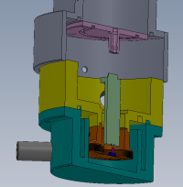
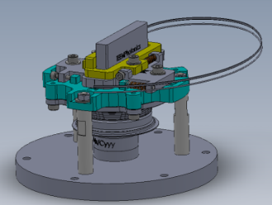
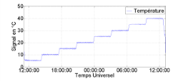
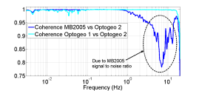
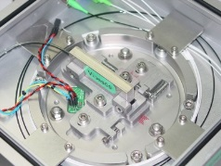
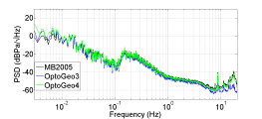
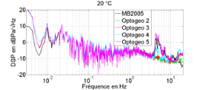
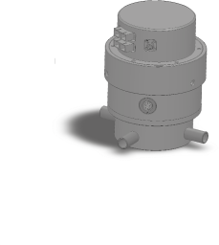
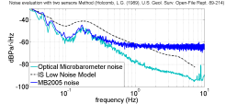



New Optical Microbarometer
(T3.1-P19)
Highlight:
CEA (designer of MB2005 and MB3) and Seismo Wave (manufacturer and seller of MB3) are associated to design and manufacture a new optical microbarometer
Objective: increase performances in terms of resolution and dynamic
Mean: replace electromagnetic transducer by Michelson interferometer
Authors(s):
Measurement principle and first prototype
First results
The future
Comparison
With MB2005
Effect of temperature and altitude
Noise evaluation
Serge OLIVIER CEA DAM DIF, F-91297, France
Anthony HUE, Nathalie OLIVIER, Serge LE MALLET SEISMO WAVE, France
Project funded by the

