Slide 1

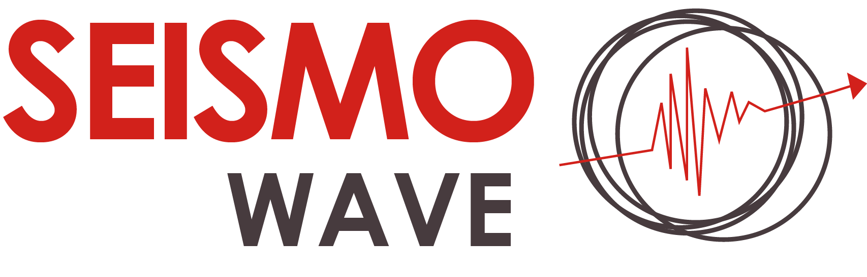
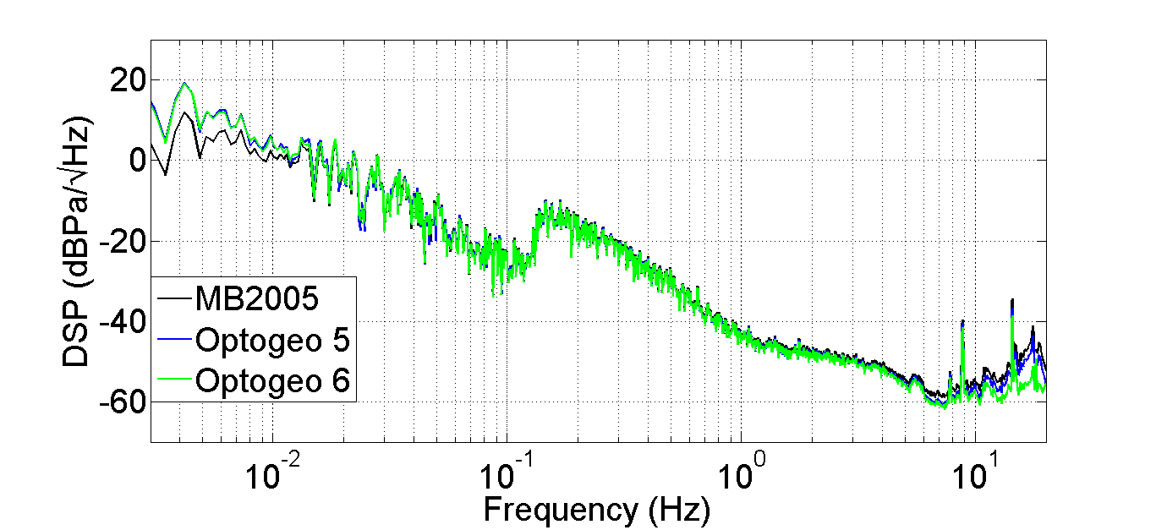
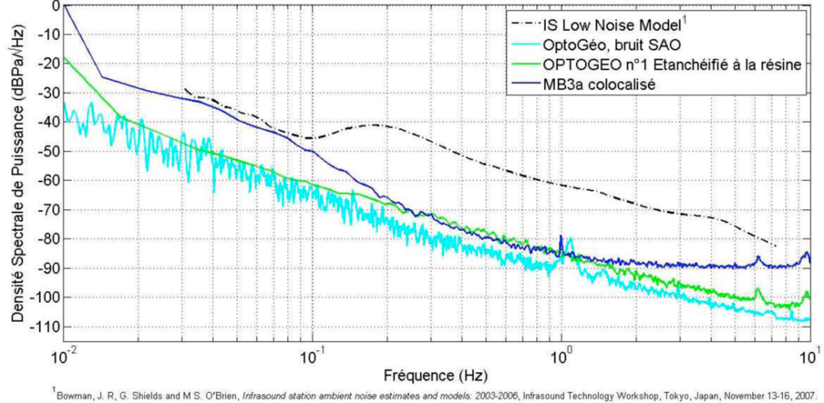
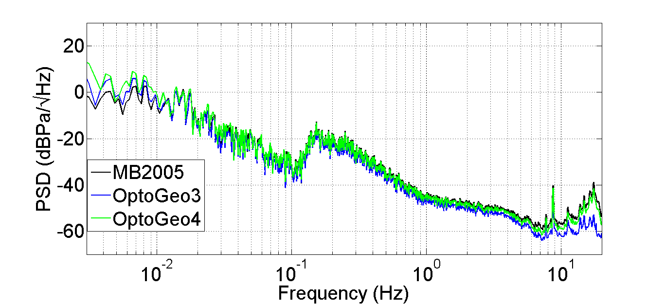
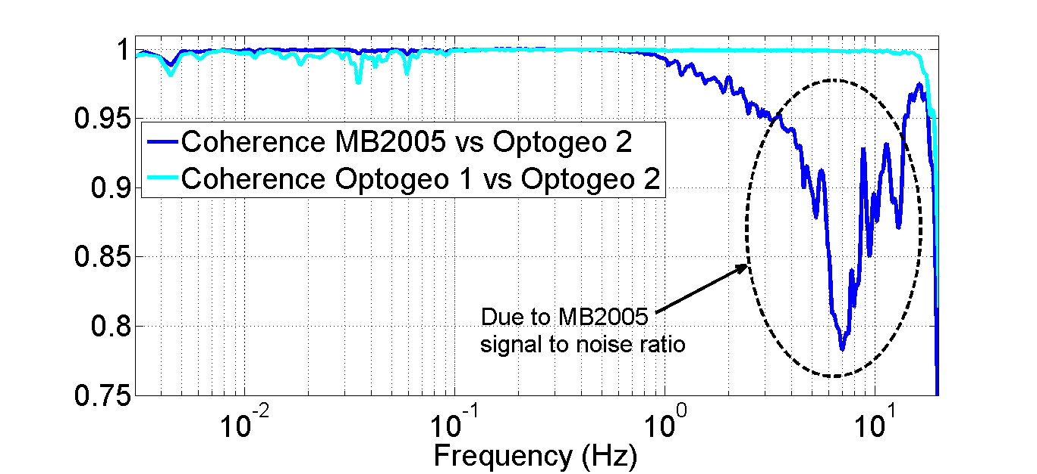
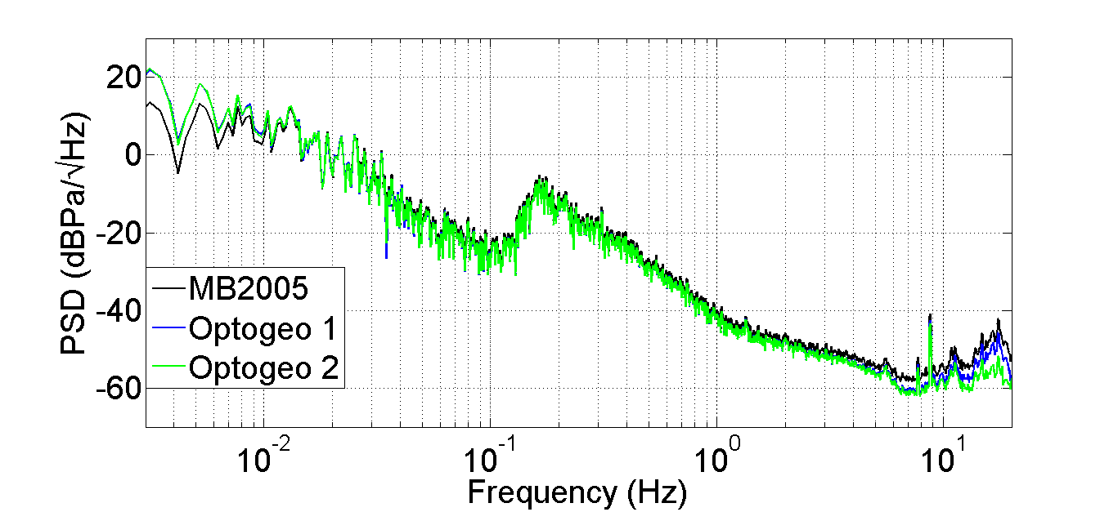
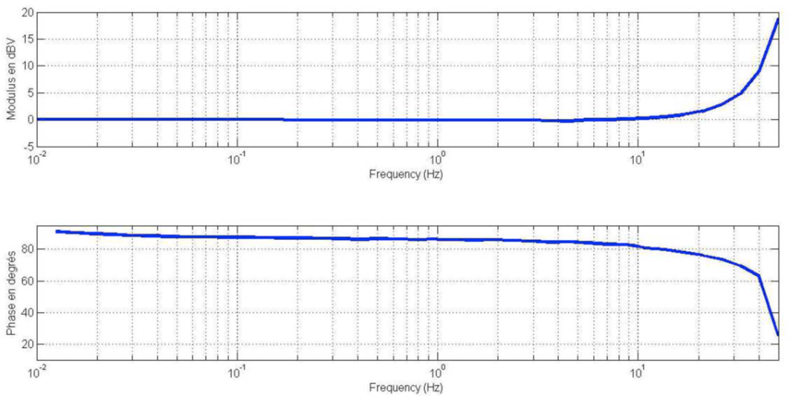
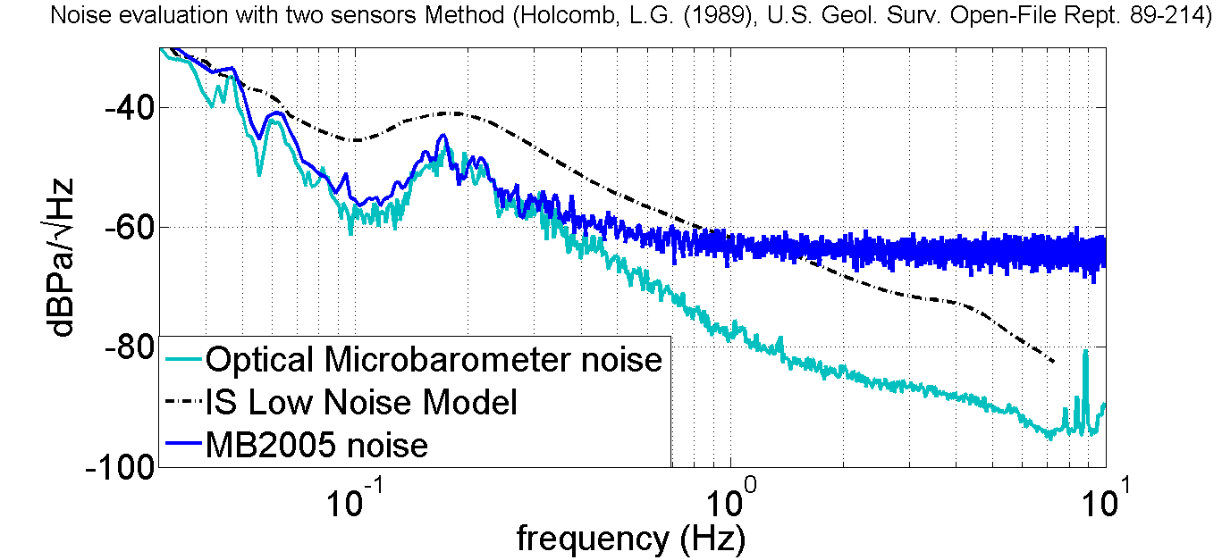
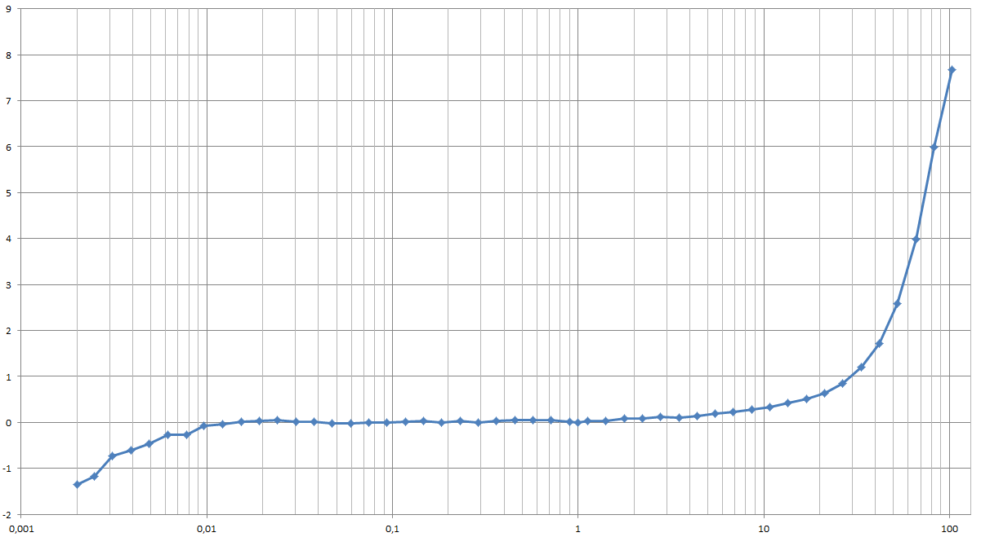
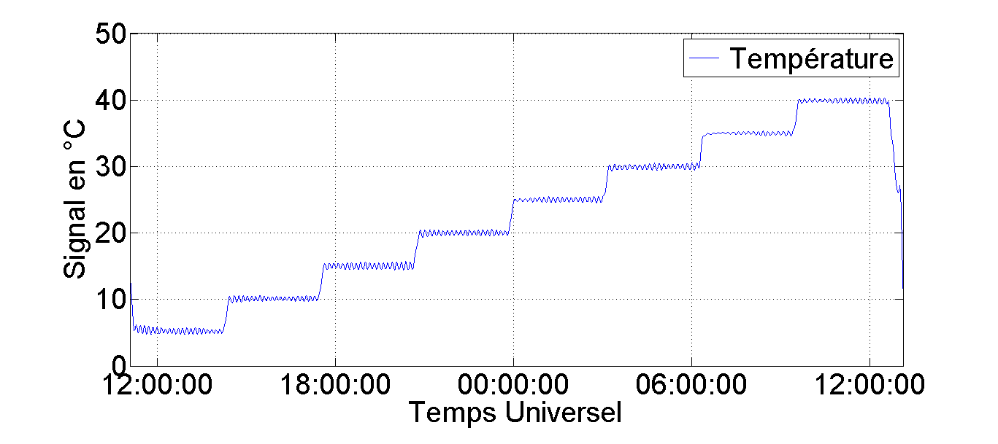
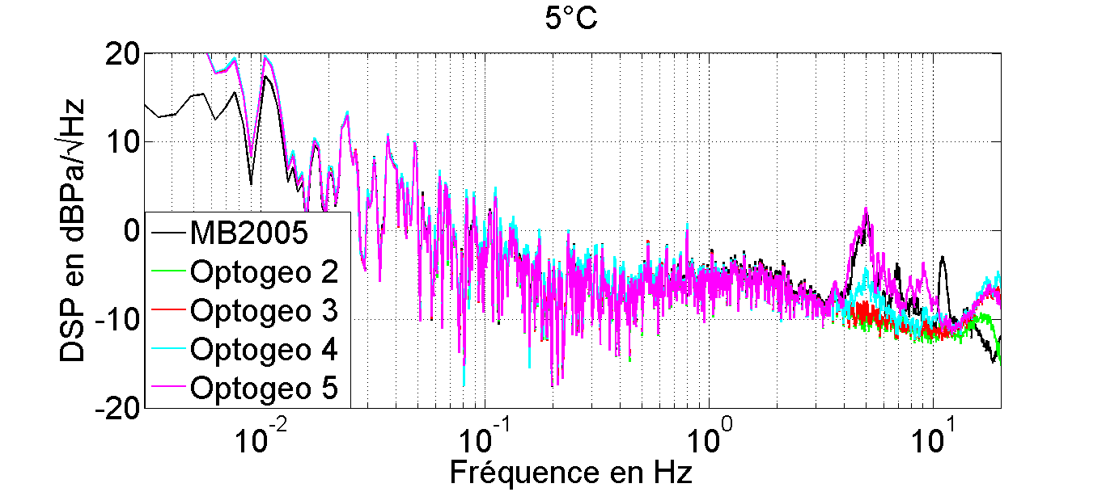
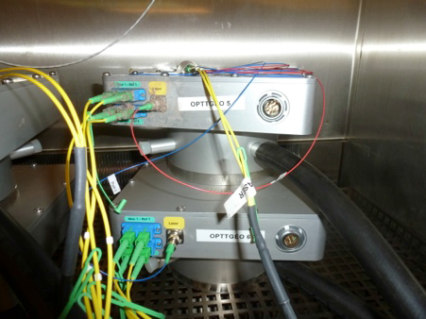
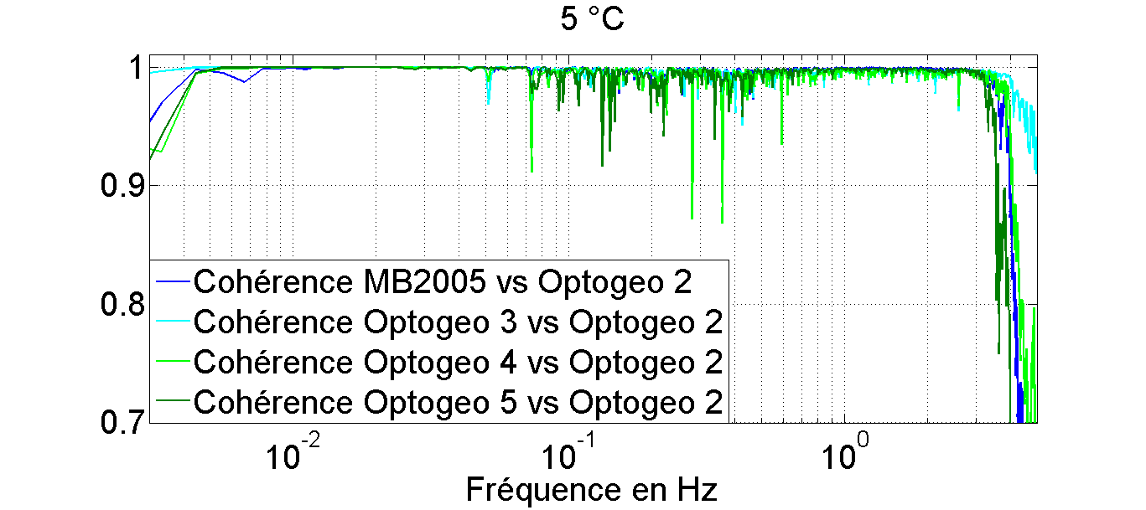
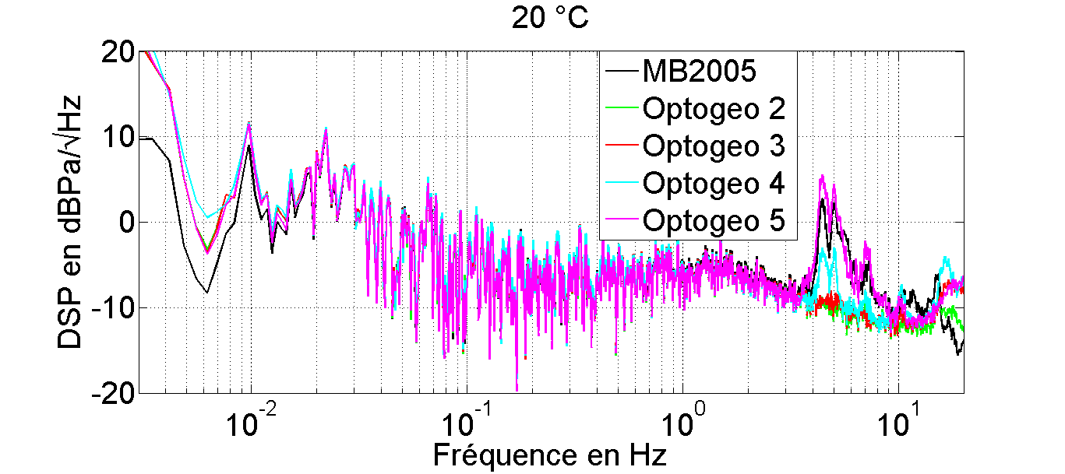
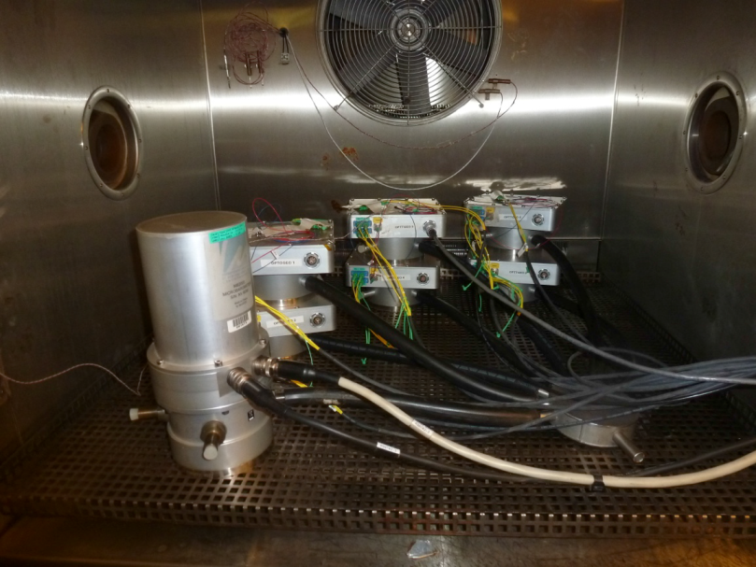
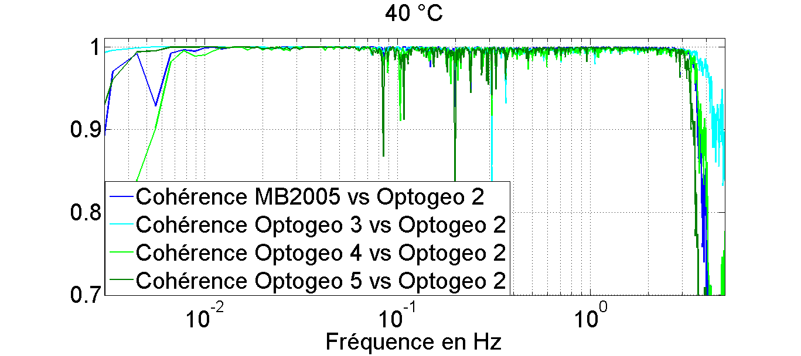
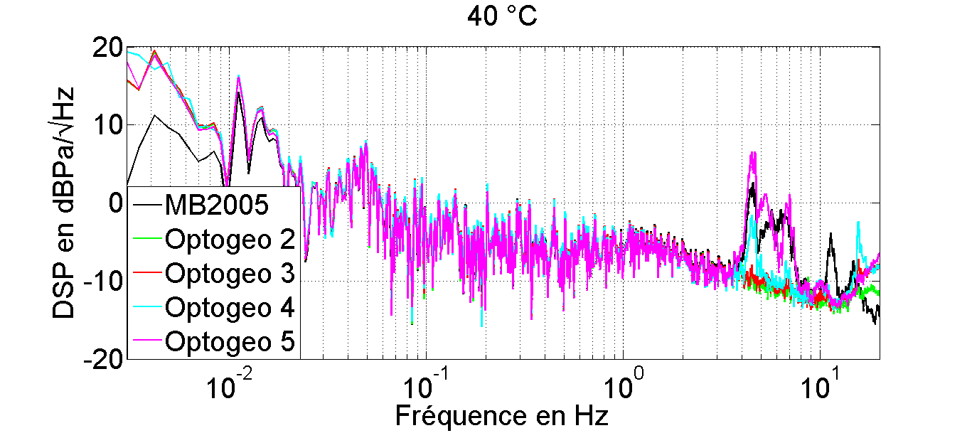
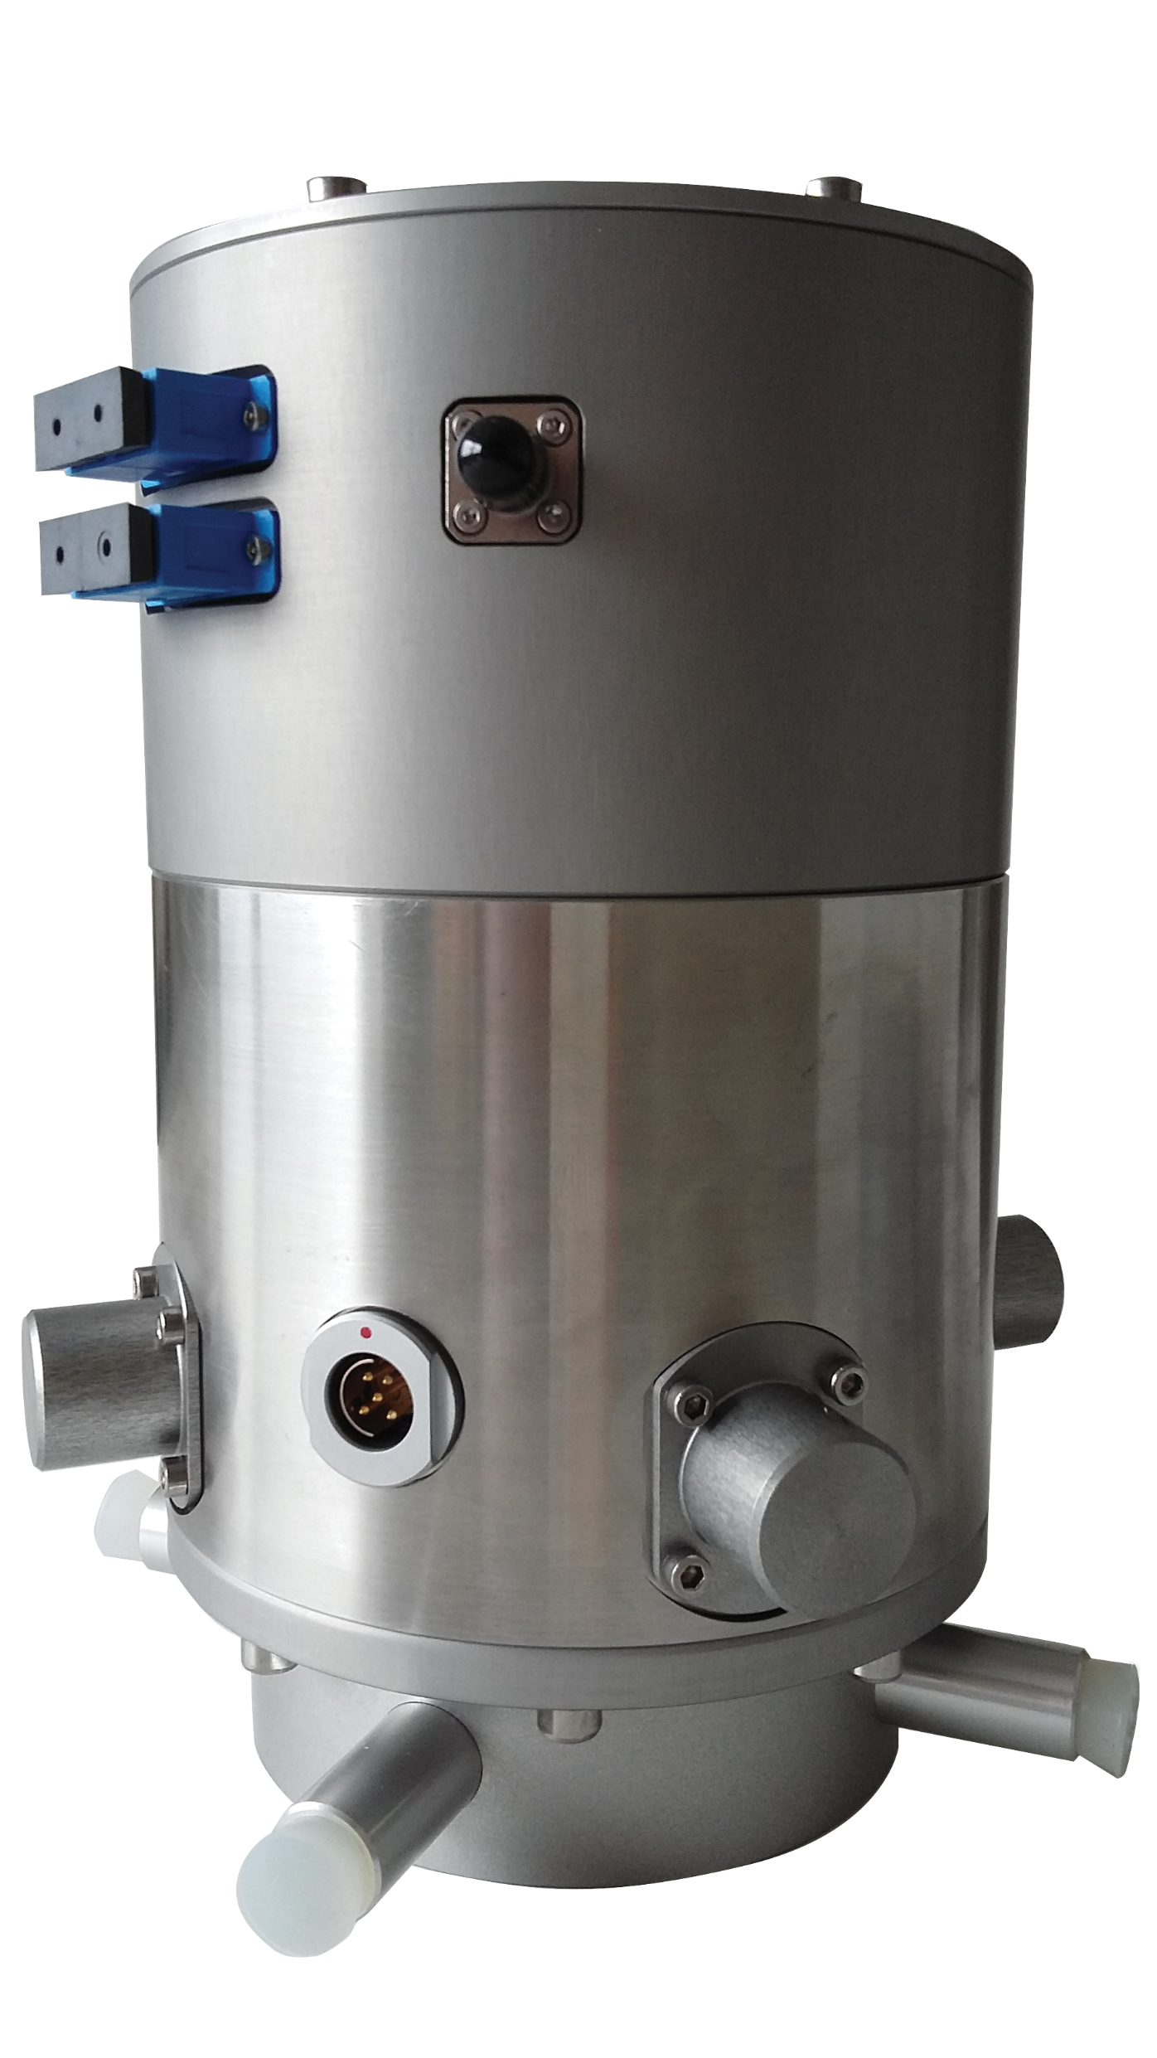
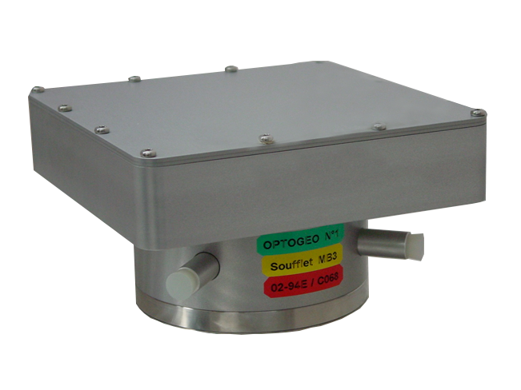

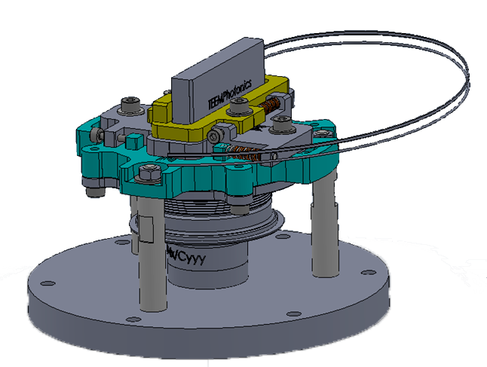
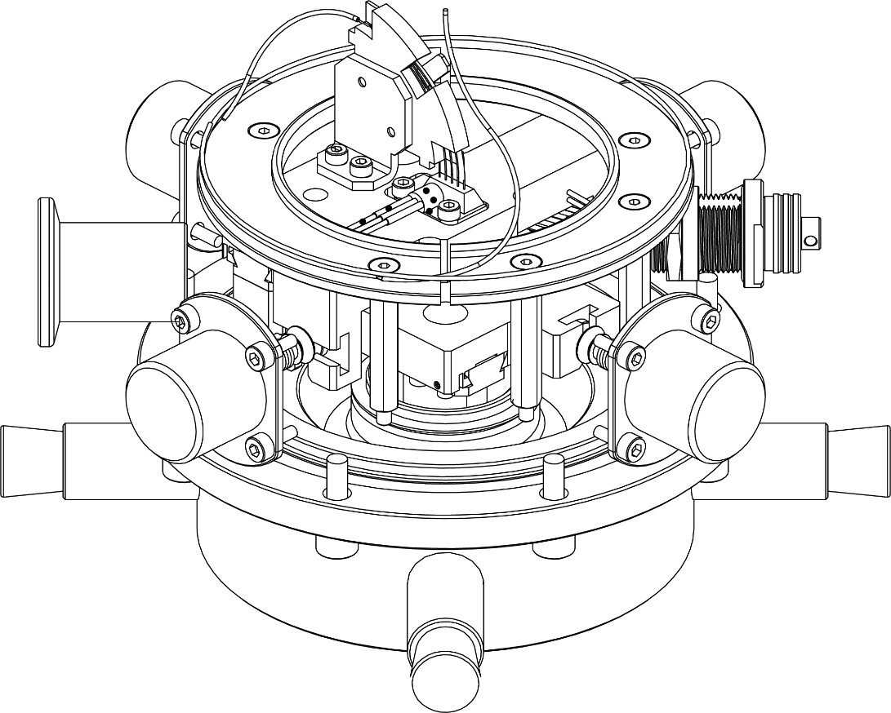

3
Comparison with MB2005
6
Final tests
Devices under test:
One microbarometer MB2005
Six optical microbarometers:
Optogeo 1, Optogeo 2 and Optogeo 3 used a MB3
aneroid capsule with the corresponding sensitivity
Optogeo 4, Optogeo 5 and Optogeo 6 used a MB2005
aneroid capsule with the corresponding sensitivity
The OptoGeo self noise (Green) is bellow than the MB3a self noise (blue) and follow the digitizer noise level (Cyan) which limits the measurement
New optical microbarometer
EGU 2017
X3.27 7505
Flat response of the transfer function on the bandwidth 0,001 Hz à 50 Hz
The phase of the sensor has a constant value unlike the other microbarometers used.
1
Microbarometer principle
Digital microbarometer
PSD & coherency:
good agreement. Optogeo sensitivity is OK
Noise evaluation:
better than MB2005 for all the bandwidth
Analog microbarometer
Pressure
variation
Mechanical transducer
Displacement
Movement transducer
Analog voltage
Digital data
Flat response of the transfer function: the defaults observed come from the environmental effects during the measurements in LF and in HF from the calibration speaker resonance
Digitizer
4
Effects of temperature
Metrology Test Bench
Optical beam
Thermal test:
From 5 °C to 40 °C
Step : 5 °C
LVDT or
Magnet-coil
Moving mirror
Vacuum
Aneroid
capsule
Interferometer
Aneroid
capsule
Conclusion
Current microbarometer
Optical microbarometer
7
2
Advantages:
Better resolution for the total bandwidth
Less sensitivity to temperature variation
No adjustment with altitude
Less optical adjustment compared with other optical technology
2 prototypes
First prototype
second prototype
Optical area
Low thermal effects on infrasound sensitivity compared to MB2005*
* MB2005 thermal drift is less than ±0.1 hPa/°C
Other interests:
OptoGeo sensor is a useful tool to characterize metrology test bench on a wider frequency bandwidth
Future works:
• Optical digitizer: lower noise, lower consumption
• Quality of the laser source
• Calibration capability
• Low frequencies test bench
5
Effects of altitude
Aneroid capsule area
Axial deformation: measurement principle
Transversal deformation: due to symmetrical errors during manufacturing
Risk: misalignment due to transversal deformation
Measurement: Observation of Optical beam intensity variation with altitude
Fiber
optic
Interferometer
Aneroid
capsule
Aneroid
capsule
Alt.= 0 m
Optical beam
Test of 2 types of capsules
MB2000 and MB3 in ambient environment
1 MB3 bellow and interferometer under vacuum
Moving mirror
Aneroid capsule
Alt.= 2000 m
S. OLIVIER CEA DAM DIF, F-91297
F-91297 Arpajon, France, serge.olivier@cea.fr
project funded by
Optical
beam
Moving
mirror
Moving mirror
Vacuum
Very low effects at an altitude of 2000 m for sensor with MB3 aneroid capsule
Low effects at an altitude of 2000 m for sensor with MB2005 aneroid sensor
A. HUE, N. OLIVIER, S. LE MALLET
SEISMO WAVE, Lannion, France,
www.seismowave.com
Optical beam
Vacuum
Interferometer
through convention n°132906059

