Slide 1


New Optical Microbarometer
This project is funded by the DGA though convention n°132906059
SnT 2017 | Serge Olivier (CEA); Anthony Hue, Nathalie Olivier, Serge Le Mallet (SeismoWave)
26th june 2017

Slide 2
SUMMARY
INTRODUCTION
MICROBAROMETER PRINCIPLES
OPTICAL TRANSDUCER PRINCIPLES
OPTICAL MICROBAROMETER
THE FIRST DESIGN
THE SECOND DESIGN
CONCLUSION

Slide 3
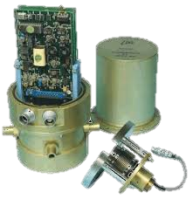
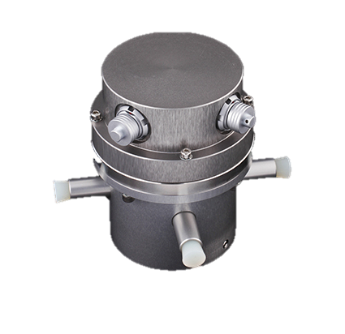
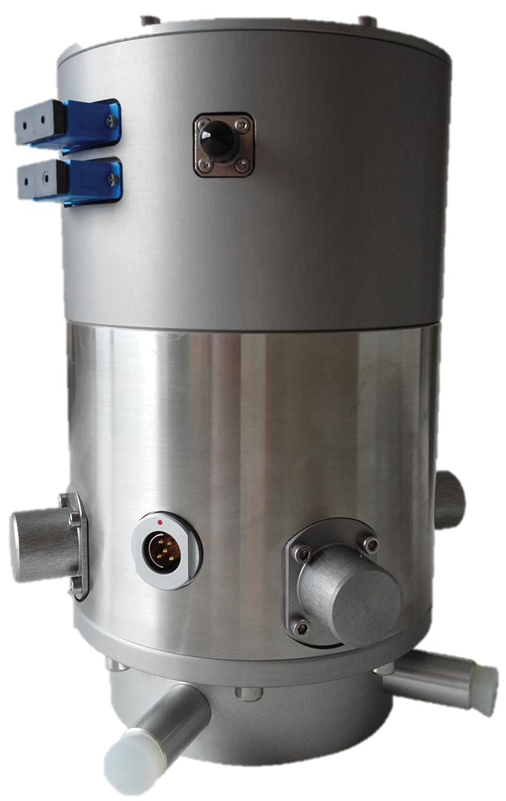


INTRODUCTION
Seismic pendulum
Electronic devices
Digitizing systems
Aneroid bellows
Metrology process
R&D
Movement transducers
Etc…
CEA microbarometer designs:
… 2000 2005 2015 Today -> Tomorrow
MB2000 MB2005 MB3
R&D : OptoGeo new optical microbarometer
French Patent 1262878
LVDT transducer
Magnet & coil
transducer
Interferometer

Slide 4
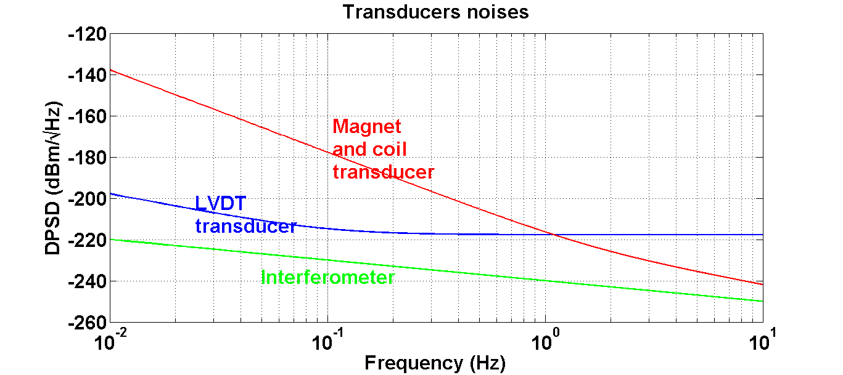
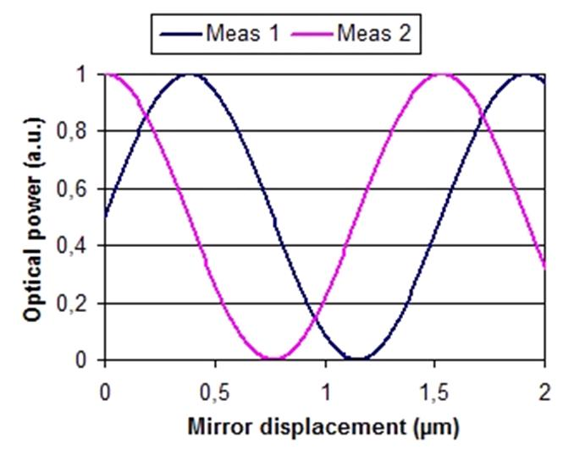
INTRODUCTION
Principles
Interferometer compared to LVDT and Magnet and Coil transducers:
Lower noise
Larger operational range
Two quadrature fringes
No limit on phase fringes measurement
Objectives
Increase performances (noise and operational range) of the sensor
No more electrical mass difficulty

Slide 5
MICROBAROMETER PRINCIPLES
Current microbarometer principle
Transducer block
MB3a Hood
DIGITIZING UNIT
ATMOSPHERIC PRESSURE
COIL OUTPUT VOLTAGE
Pressure Dérivative
Measurement cavity
Magnet & coil transducer
SIGNAL AMPLIFICATION
SIGNAL SYMMETRIZATION
dP +
dP -
Pressure
Aneroid bellows
ACTIVE LOW PASS FILTER
SIGNAL SYMMETRIZATION
P +
P -
MB3a microbarometer

Slide 6
MICROBAROMETER PRINCIPLES
Magnet and coil transducers principle
Transducer block
MB3a Hood
DIGITIZING UNIT
ATMOSPHERIC PRESSURE
COIL OUTPUT VOLTAGE
Pressure Dérivative
Measurement cavity
Magnet & coil transducer
SIGNAL AMPLIFICATION
SIGNAL SYMMETRIZATION
dP +
dP -
Pressure
Aneroid bellows
ACTIVE LOW PASS FILTER
SIGNAL SYMMETRIZATION
P +
P -
MB3a microbarometer
OK
Replaced by an optical transducer and a specific digitizer

Slide 7
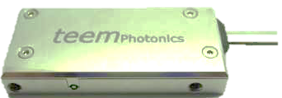
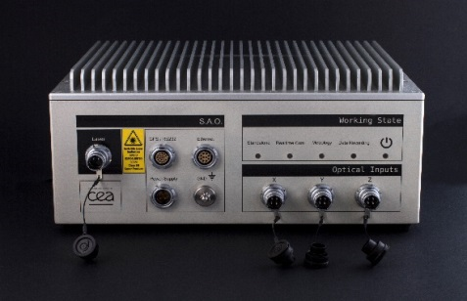
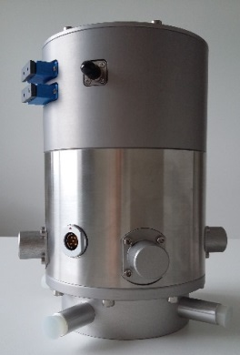
Optical microbarometer
Interferometer
Moving mirror (Cat’s eye)
Aneroid
bellows
Transducer block
Interferometer
ATMOSPHERIC PRESSURE
- DIGITIZING and PROCESSING
System
- laser source
Measurement cavity
Moving miror
Optical signals
Pa/s / count
Aneroid bellows
Bellows sensitivity = 122nm/Pa
Optical microbarometer

Slide 8
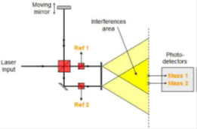
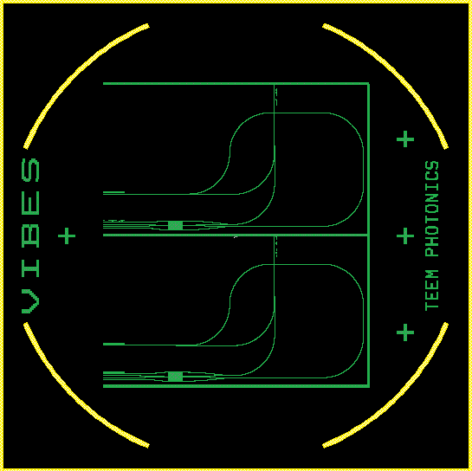
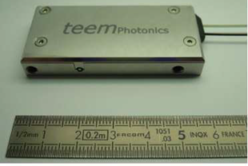
Interferometric Transducer
Interferometer principle
« Mic-Mac » interferometer: One Michelson arm and one Mach-Zehnder arm
2 quadrature fringes to compute the phase:
Meas1 & Meas2
2 photometric signals to control photometric variations
Ref1 & Ref2
Interferometer technology: integrated optics
Interferometer is designed with optical waveguide obtained by ion-exchange process into a glass wafer
Less adjustment than standard interferometer
Interferometer is included into a compact package

Slide 9
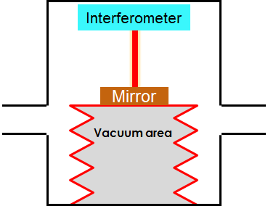
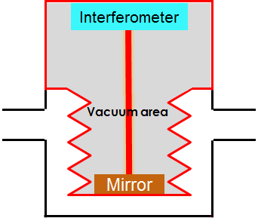
Optical microbarometer
2 steps to design the optical microbarometer
Step 1: Concept validation
Interferometer outside the aneroid bellows
Step 2: Fully integrated prototype
Interferometer inside the aneroid bellows

Slide 10
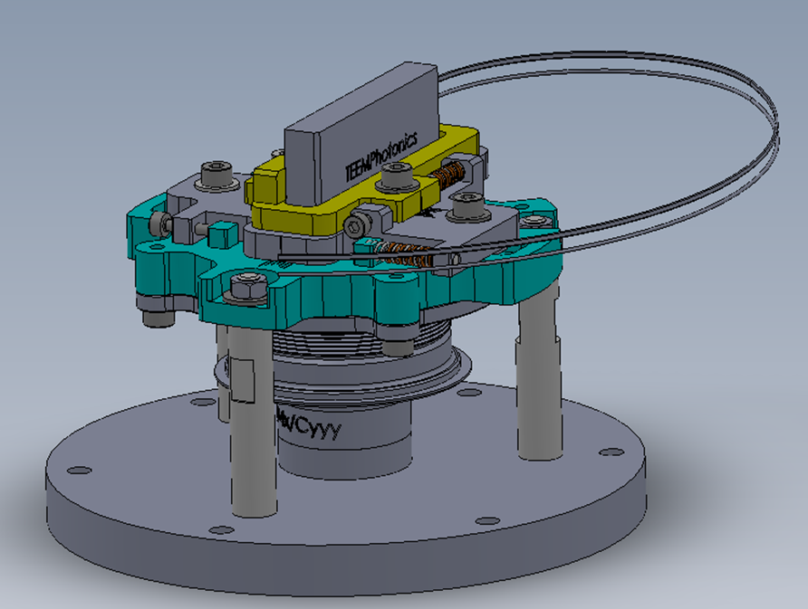
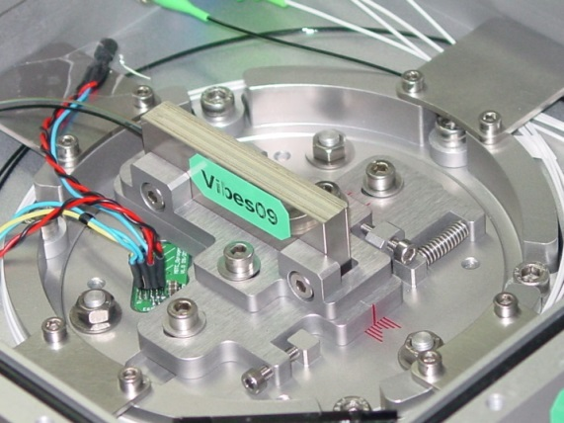
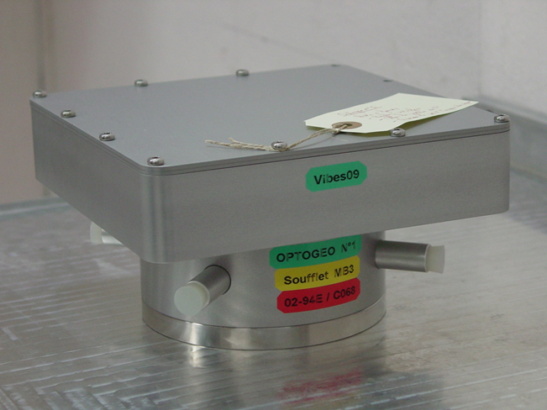
First design
Objectives:
to characterize the main components (aneroid bellows, interferometer)
6 prototypes
3 with a MB3a bellows (OptoGeo 1,2,3)
3 with a MB2005 aneroid bellows (OptoGeo 4,5,6)

Slide 11
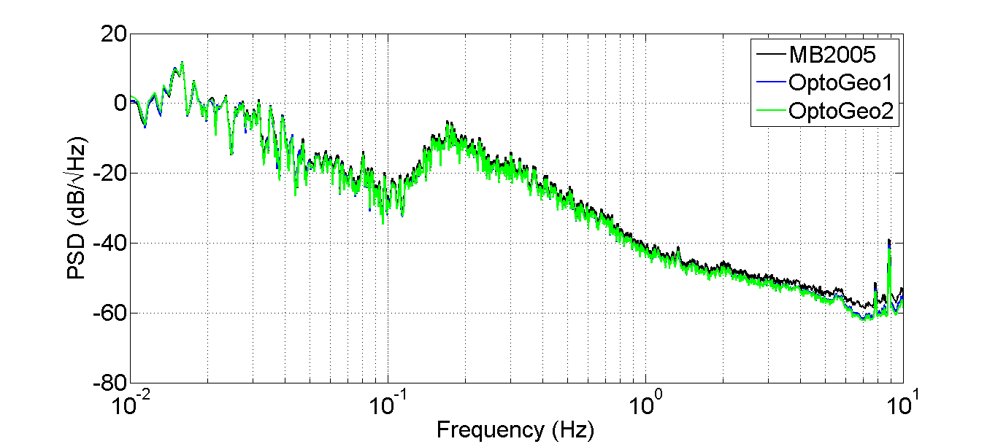
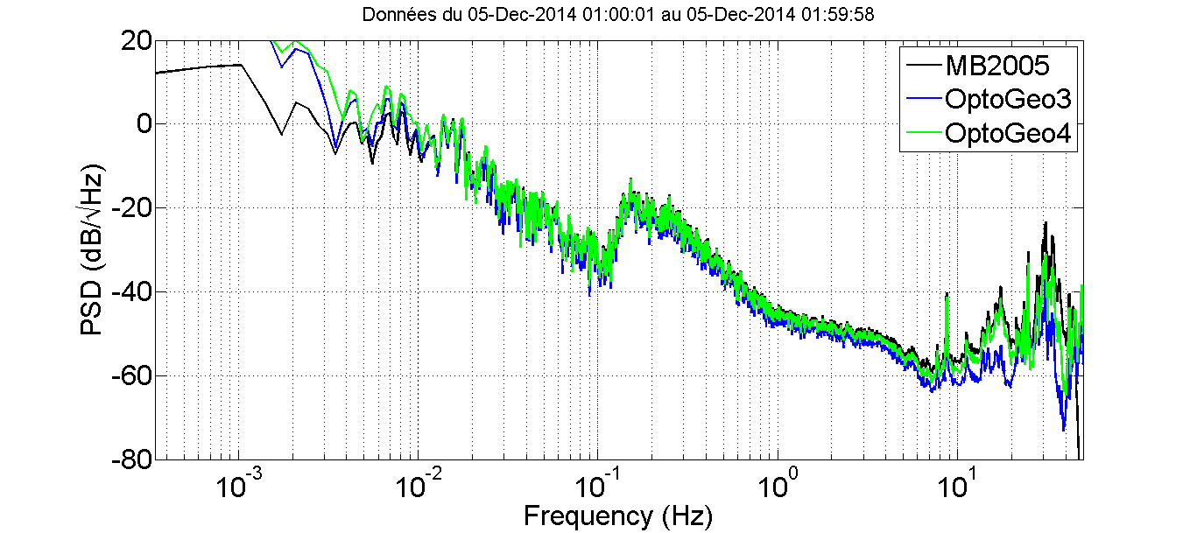
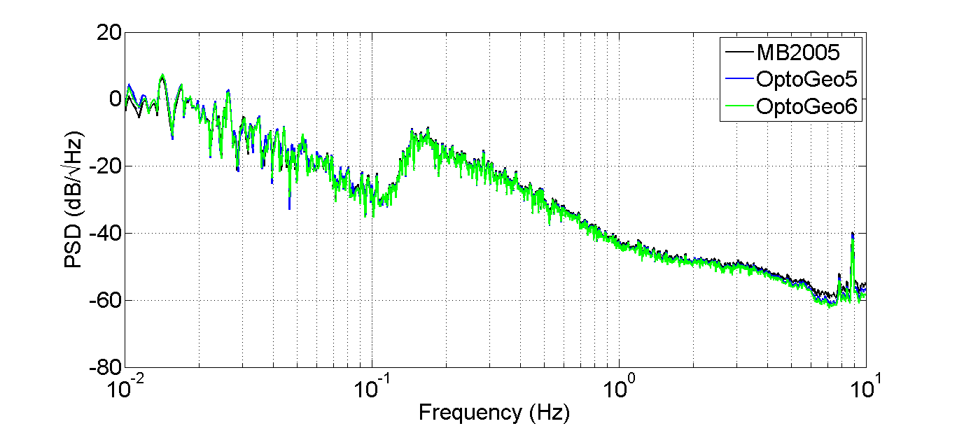
First design measurements
Experiment:
6 OptoGeo + 1 MB2005 (reference sensor)
Observations of the same signal
Comparison between each sensor measurement to validate the OptoGeo measurement
Results:
Signal PSD is similar for all sensors in a wide bandwidth
High frequency: seismic sensitivity

Slide 12
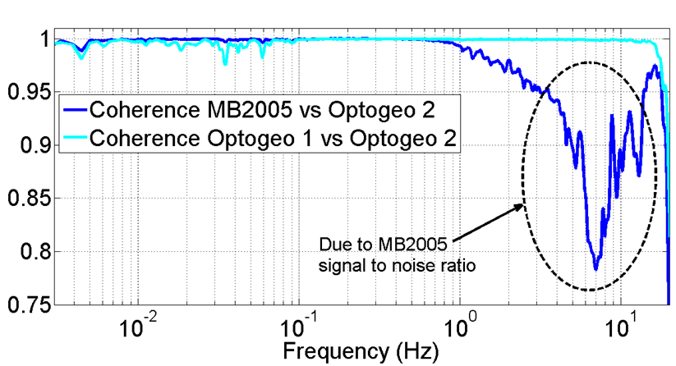
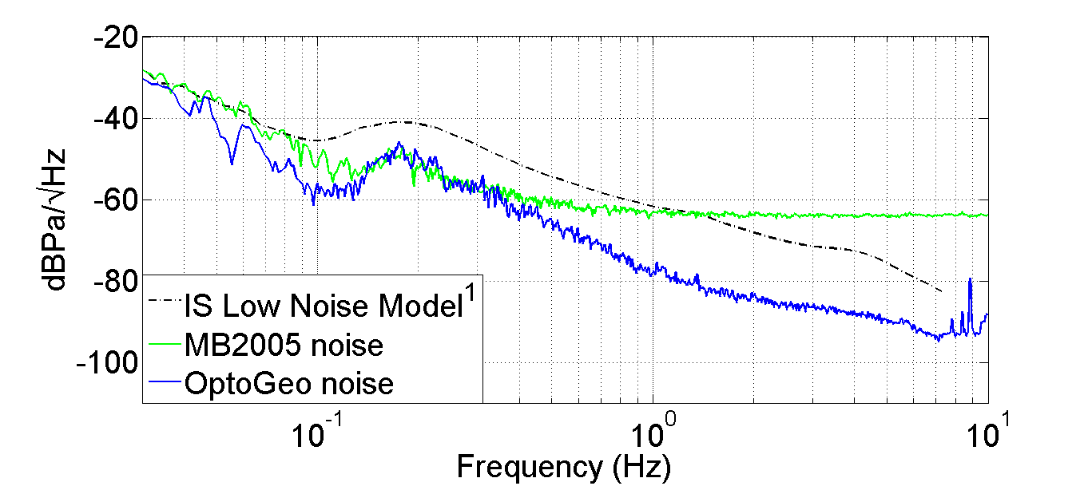
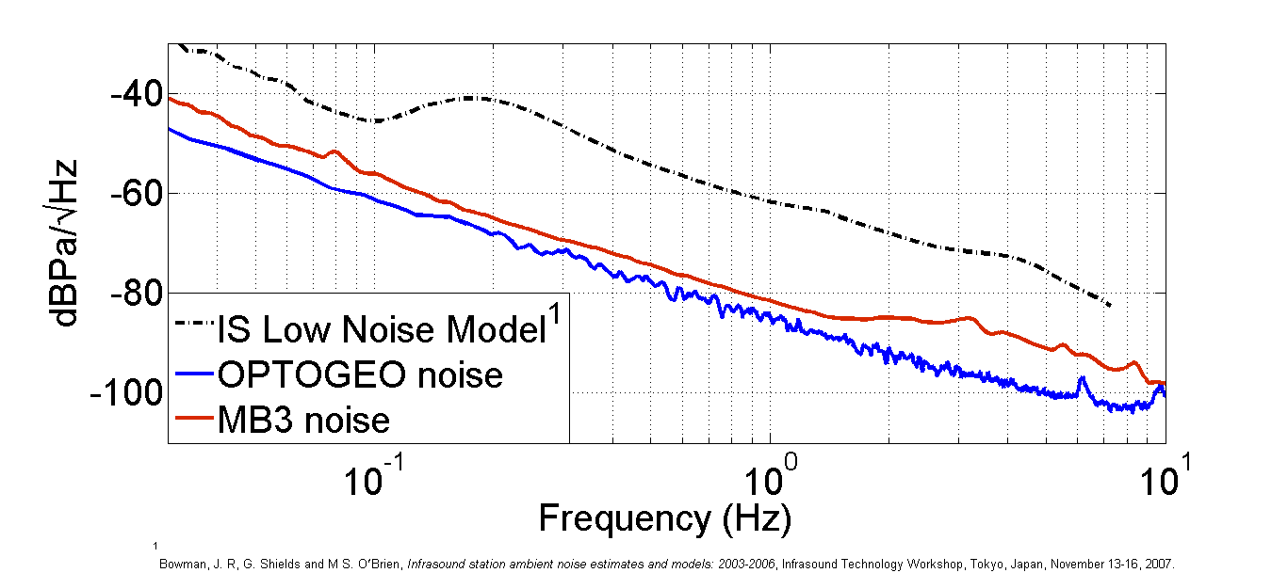
First design measurements
Coherence:
Between MB2005 and each OptoGeo:
> 0,98 on a large bandwidth
f > 1 Hz: noise level of MB2005
Between 2 OptoGeo:
> 0,98 on all the bandwidth
Noise evaluation:
2 sensors method (Holcomb, L.G., 1989)
Better noise for OptoGeo than MB2005
Between 0,1 and 0,3 Hz: due to evaluation method
Optimization of measurement cavity
Noise measurement
Better noise than MB2005 and MB3

Slide 13
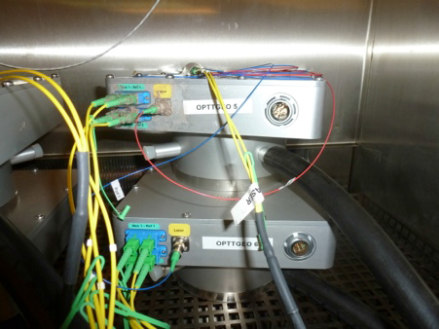
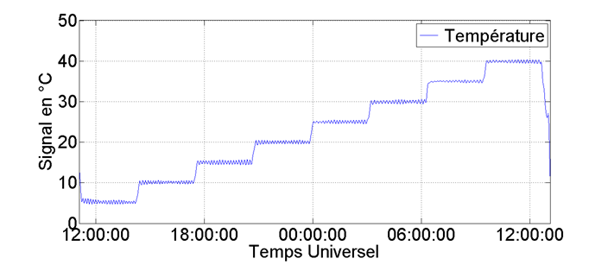
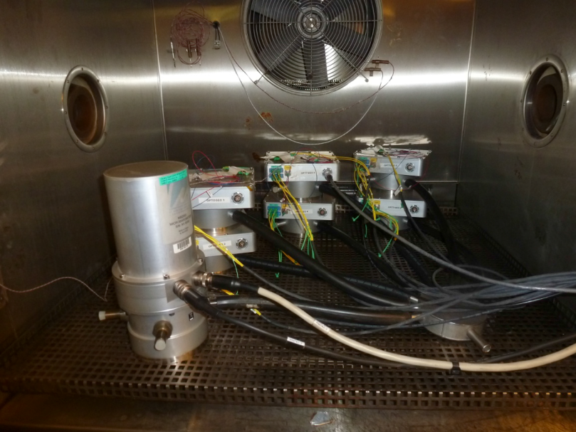
First design measurements
Thermal test:
Temperature from 5 to 40 °C
Steps = 5 °C

Slide 14
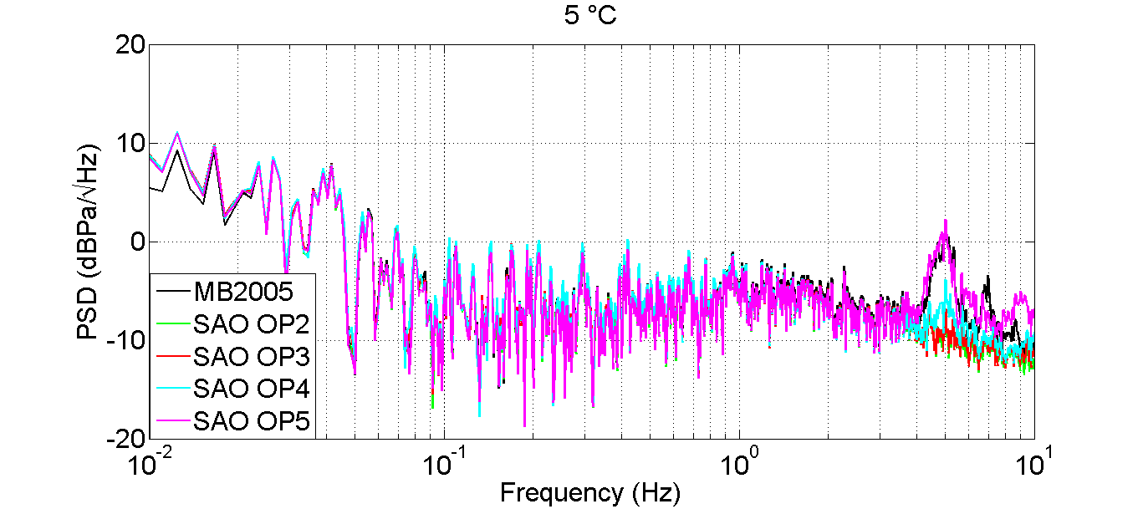
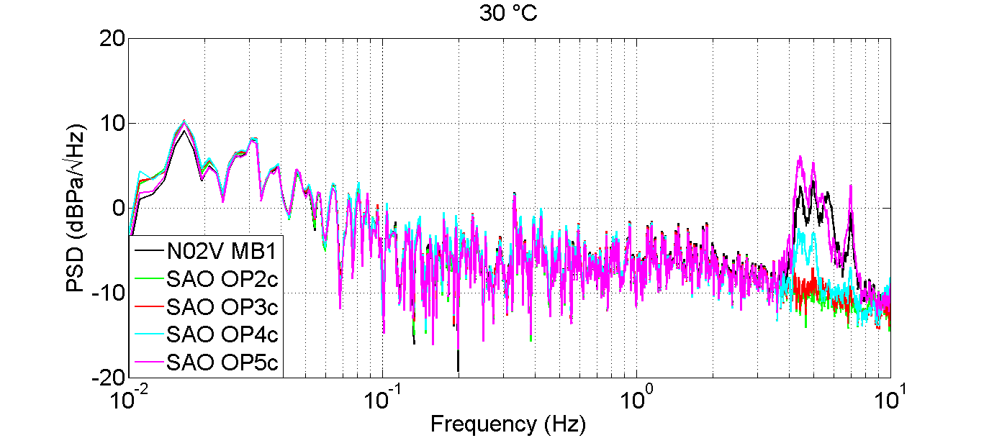
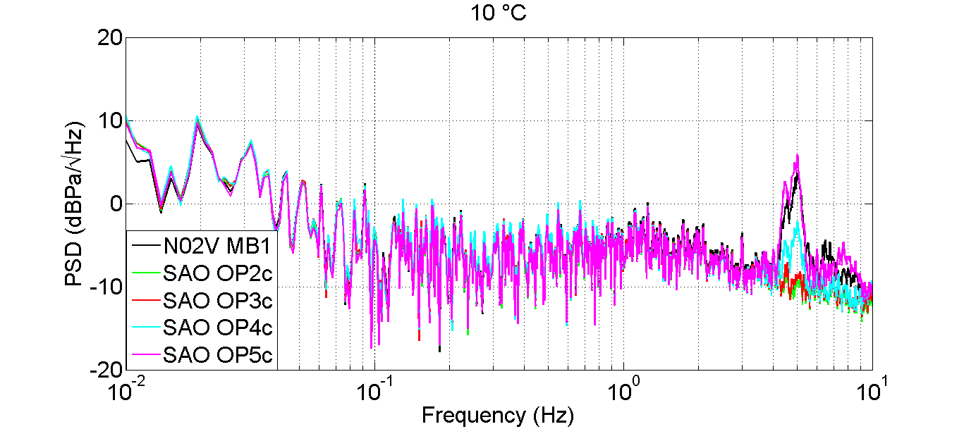
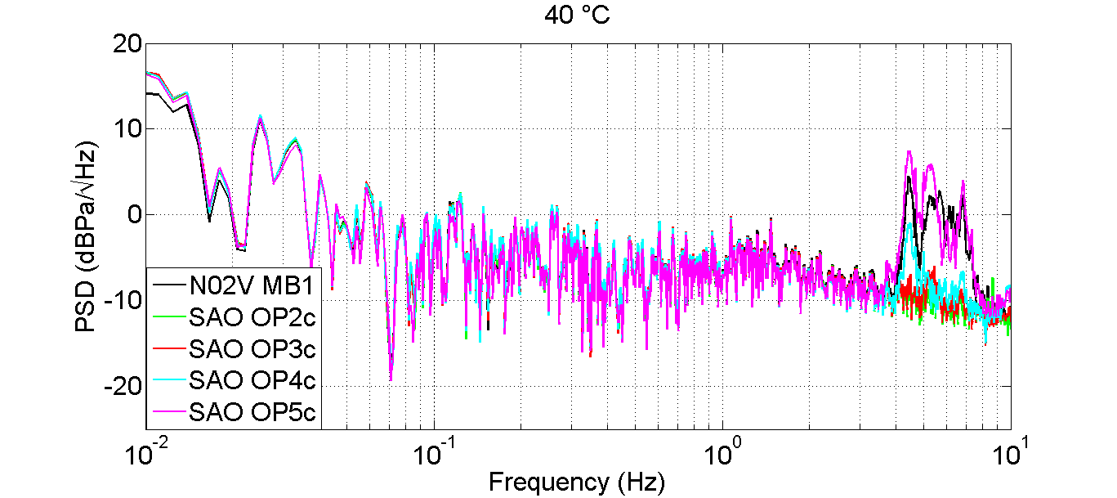
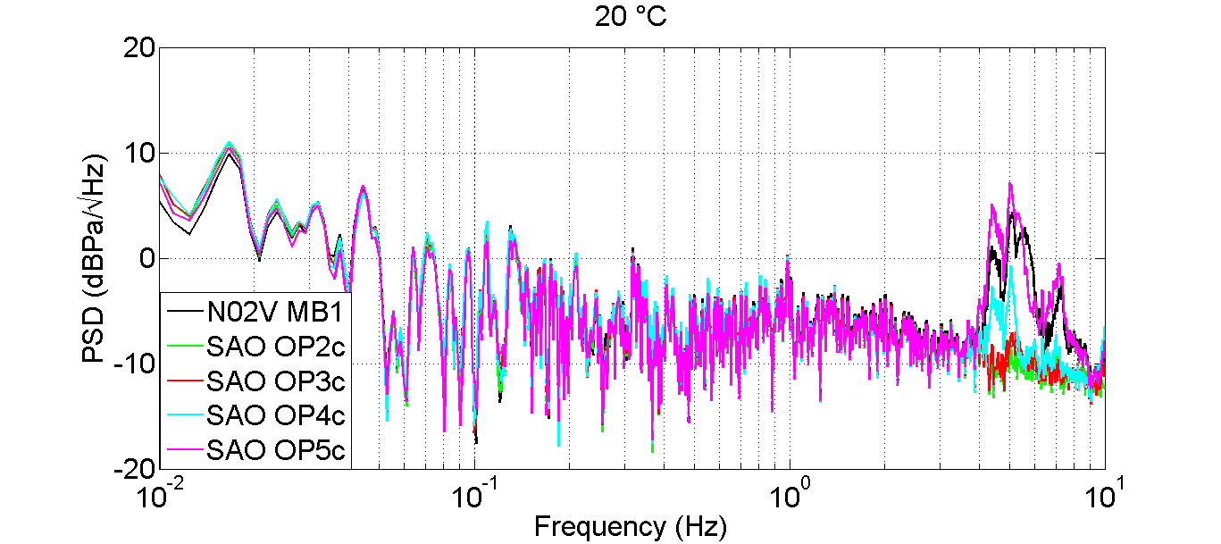
First design measurements
Results:
Thermal effects on sensitivity comparable to MB2005

Slide 15
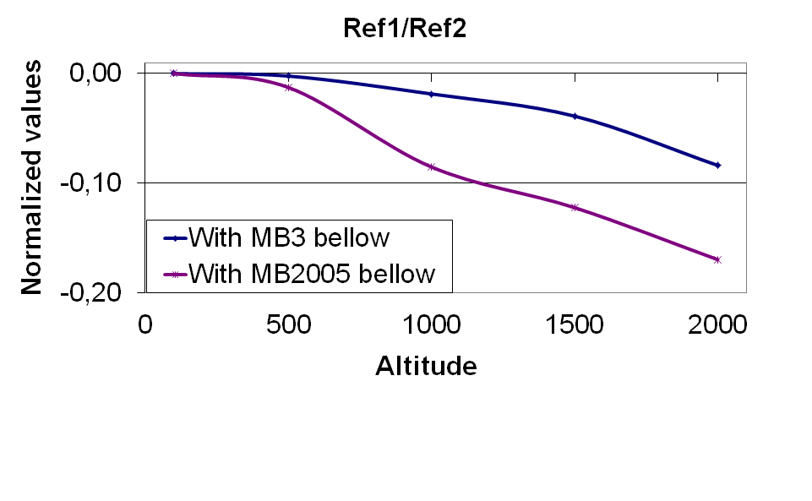
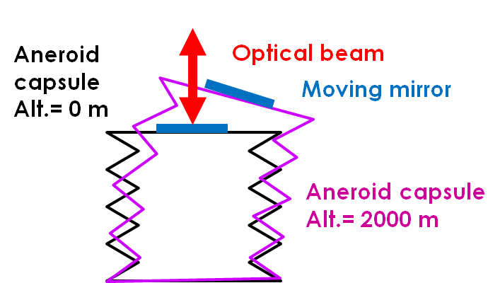
First design measurements
Effects of altitude:
Expected: no effect due to interferometric measurement principle
Transversal deformation due to symmetrical errors during manufacturing
Measurement: The 2 photometric signals at 5 different altitudes
Results:
No complete loss of reflected optical beam: OptoGeo always gives reliable measurements
Lower effects for OptoGeo with MB3 aneroid bellows
Larger operational range than MB3 & MB2005
Optogeo will be usable in all CTBTO stations without any adjustment

Slide 16
First design
Sum up:
Significantly lower noise than MB2005 and slightly lower than MB3
Temperature effects on sensitivity: similar to MB2005/MB3 microbarometers
Altitude effects:
Larger operational range than MB3&MB2005
No adjustment
Conclusion:
Encouraging results for the following design
Choice of MB3 aneroid bellows
Following design: interferometer inside the aneroid bellows
optical components protection (humidity, dust, …)

Slide 17
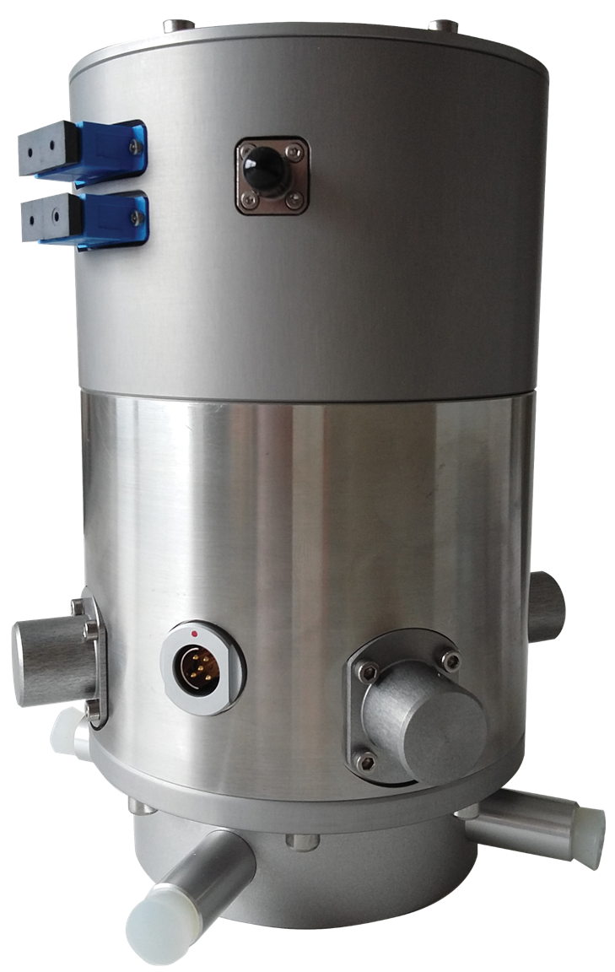
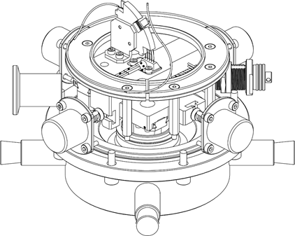
Second design
4 prototypes
With MB3 aneroid bellows
Challenges:
Smaller interferometer under vacuum
To adjust the interferometer and mirror positions from the outside of aneroid bellows
Goal:
Insert the interferometer inside the aneroid bellows, under vacuum to avoid environmental perturbations (humidity, dust, …)
sealed leading-through device
Vacuum
valve
Adjustment system
interferometer

Slide 18
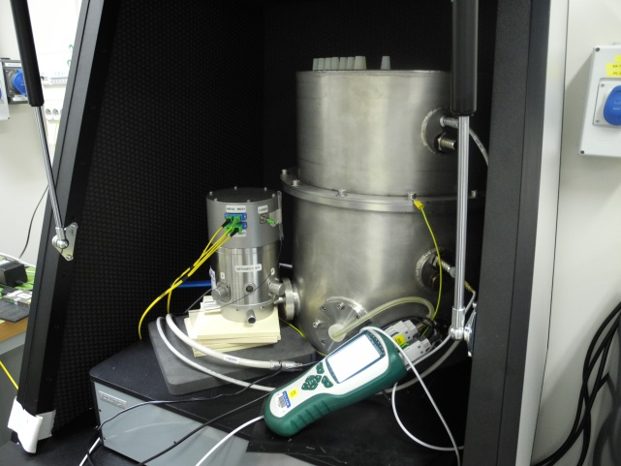
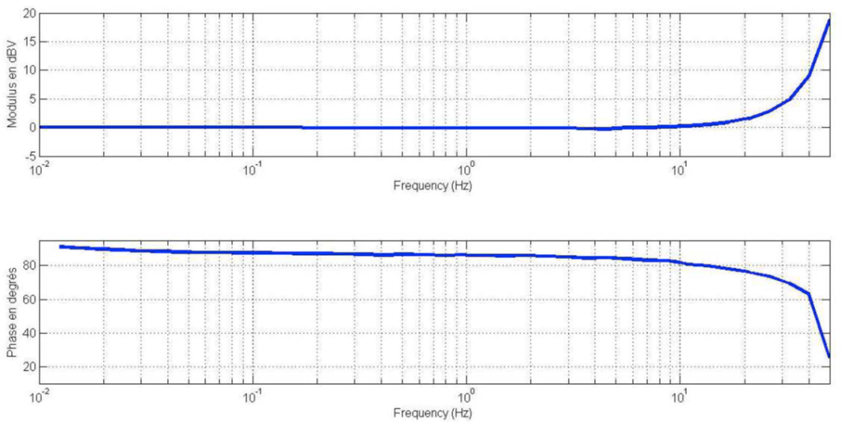
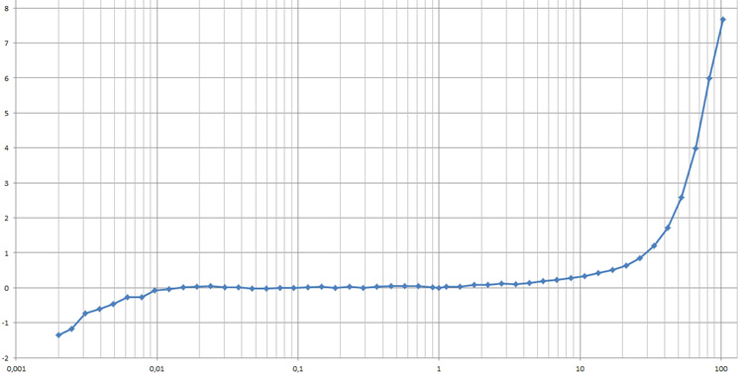
Second design experiment
Transfer function measurement:
Use of infrason metrology test bench (IS Calibrator)
Effects of the test bench
+/- 0,5 dB
Flat response on a large bandwidth

Slide 19
Conclusion
SUM UP
Flat instrumental response on all the bandwidth: interesting for metrology (possibility for secondary standard)
Very interesting results
Feasibility prouved
Lower noise than MB2005 on all the bandwidth
Temperature effects: similar to present microbarometers
Altitude effects: no adjustment
Better static dynamic
Robustness of optical fiber connectors
Mechanical design to improve (adjustment bellows, …)
« Optical » digitizer: lower noise, lower consumption
Quality of the laser source (lower phase noise)
FUTURE WORKS
Application for seismic VBB sensors: launching a new 3 years program of R&D (Project under contractualization with DGA)

Slide 20
DAM DASE STMG
Commissariat à l’énergie atomique et aux énergies alternatives
Centre DIF | 91297 Arpajon Cedex
Etablissement public à caractère industriel et commercial | RCS Paris B 775 685 019

